Slide 1
High Availability for RHEL on System z
David Boyes
Sine Nomine Associates

Slide 2
Agenda
Clustering
High Availability
Cluster Management
Failover
Fencing
Lock Management
GFS2

Slide 3
Clustering
Four types
  Storage
  High Availability
  Load Balancing
  High Performance

Slide 4
High Availability
Eliminate Single Points of Failure
Failover
Simultaneous Read/Write
Node failures invisible outside the cluster
rgmanager is the core software

Slide 5
High Availability
Major Components
  Cluster infrastructure — Provides fundamental functions for nodes to work together as a cluster
    Configuration-file management, membership management, lock management, and fencing
  High availability Service Management — Provides failover of services from one cluster node to another in case a node becomes inoperative
  Cluster administration tools — Configuration and management tools for setting up, configuring, and managing the High Availability Implementation

Slide 6
High Availability
Other Components
  Red Hat GFS2 (Global File System 2) — Provides a cluster file system for use with the High Availability Add-On. GFS2 allows multiple nodes to share storage at a block level as if the storage were connected locally to each cluster node
  Cluster Logical Volume Manager (CLVM) — Provides volume management of cluster storage
  Load Balancer — Routing software that provides IP-Load-balancing

Slide 7
Cluster Infrastructure
Cluster management
Lock management
Fencing
Cluster configuration management

Slide 8
Cluster Management
CMAN
  Manages quorum and cluster membership
  Distributed manager that runs in each node
  Tracks membership and notifies other nodes

Slide 9
Failover Management
Failover Domains - How the RGManager failover domain system work
Service Policies - rgmanager's service startup and recovery policies
Resource Trees - How rgmanager's resource trees work, including start/stop orders and inheritance
Service Operational Behaviors - How rgmanager's operations work and what states mean
Virtual Machine Behaviors - Special things to remember when running VMs in a rgmanager cluster
ResourceActions - The agent actions RGManager uses and how to customize their behavior from the cluster.conf file.
Event Scripting - If rgmanager's failover and recovery policies do not fit in your environment, you can customize your own using this scripting subsystem.

Slide 10
Fencing
The disconnection of a node from the cluster's shared storage. Fencing cuts off I/O from shared storage, thus ensuring data integrity
The cluster infrastructure performs fencing through the fence daemon: fenced
CMAN determines that a node has failed and communicates to other cluster-infrastructure components that the node has failed
fenced, when notified of the failure, fences the failed node

Slide 11
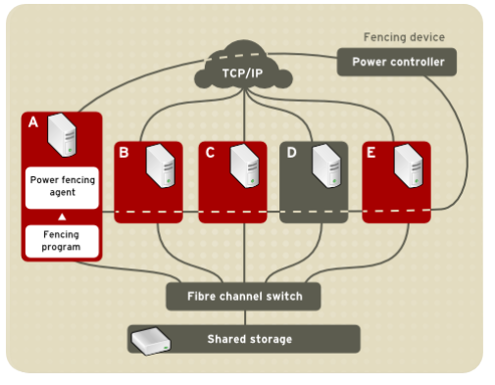
Power Fencing

Slide 12
z/VM Power Fencing
Two choices of SMAPI-based fence devices
  IUCV-based
  TCP/IP
Uses image_recycle API to fence a node
Requires SMAPI configuration update to AUTHLIST:
Column 1 Column 66 Column 131
| | |
V V V
XXXXXXXX ALL IMAGE_OPERATIONS

Slide 13
Lock Management
Provides a mechanism for other cluster infrastructure components to synchronize their access to shared resources
DLM – Distributed Lock Manager used in RHEL systems
Lock management is distributed across all nodes in the cluster. GFS2 and CLVM use locks from the lock manager
GFS2 uses locks from the lock manager to synchronize access to file system metadata (on shared storage)
CLVM uses locks from the lock manager to synchronize updates to LVM volumes and volume groups (also on shared storage)
rgmanager uses DLM to synchronize service states.

Slide 14
GFS2
A shared disk file system for Linux computer clusters
GFS2 differs from distributed file systems (such as AFS, Coda, or InterMezzo) because it allows all nodes to have direct concurrent access to the same shared block storage
GFS2 can also be used as a local filesystem.
GFS has no disconnected operating-mode, and no client or server roles: All nodes in a GFS cluster function as peers
Requires hardware to allow access to the shared storage, and a lock manager to control access to the storage
GFS2 is a journaling file system

Slide 15
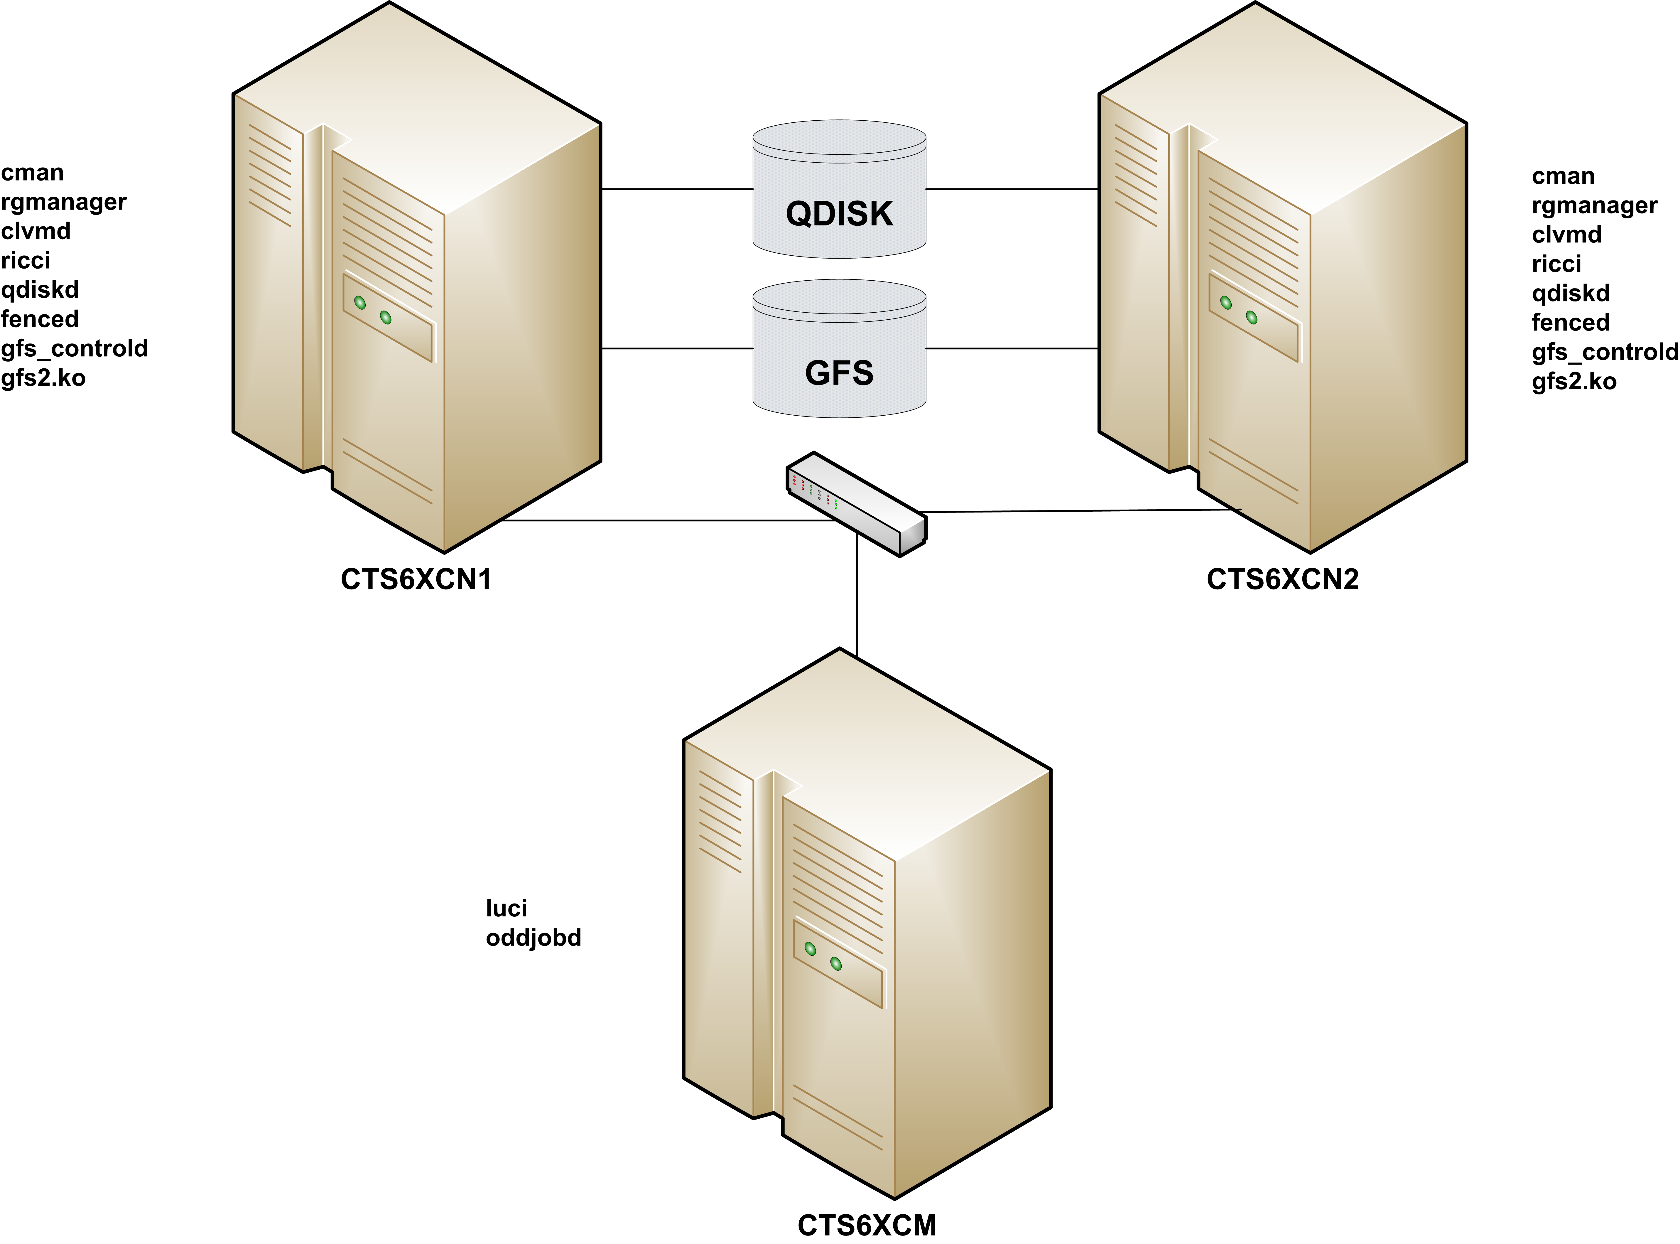
Sample Configuration

Slide 16
Sample Configuration
USER CTS6XCN1 XXXXXXXX 768M 2G G
*FL= N
ACCOUNT 99999999 GENERAL
MACHINE ESA
*AC= 99999999
COMMAND SET VSWITCH VSWITCH2 GRANT &USERID
COMMAND COUPLE C600 TO SYSTEM VSWITCH2
IUCV VSMREQIU
IPL CMS PARM AUTOCR FILEPOOL USER01
CONSOLE 0009 3215 T OPERATOR
SPOOL 00C 2540 READER *
SPOOL 00D 2540 PUNCH A
SPOOL 00E 1403 A
LINK MAINT 190 190 RR
LINK MAINT 19E 19E RR
NICDEF C600 TYPE QDIO DEVICES 3
MDISK 150 3390 3116 3338 CO510C MR
MDISK 151 3390 6286 3338 CO5109 MR
MDISK 153 3390 0001 3338 CO520E MW
MDISK 200 3390 3007 0020 CO510F MW
USER CTS6XCN2 XXXXXXXX 768M 2G G 64
*FL= N
ACCOUNT 99999999 LINUX
MACHINE ESA
*AC= 99999999
COMMAND SET VSWITCH VSWITCH2 GRANT &USERID
COMMAND COUPLE C600 TO SYSTEM VSWITCH2
IUCV VSMREQIU
IPL CMS PARM AUTOCR FILEPOOL USER01
CONSOLE 0009 3215 T OPERATOR
SPOOL 00C 2540 READER *
SPOOL 00D 2540 PUNCH A
SPOOL 00E 1403 A
LINK MAINT 190 190 RR
LINK MAINT 19E 19E RR
LINK CTS6XCN1 153 152 MW
LINK CTS6XCN1 200 200 MW
NICDEF C600 TYPE QDIO DEVICES 3
MDISK 150 3390 0001 3338 CO5204 MR
MDISK 151 3390 4281 3338 CO5107 MR

Slide 17
Sample Configuration
<?xml version="1.0"?>
<cluster config_version="23" name="SNATEST">
<clusternodes>
<clusternode name="cts6xcn1.devlab.sinenomine.net" nodeid="1">
<fence>
<method name="SMAPITCP">
<device name="SMAPITCP" target="CTS6XCN1"/>
</method>
</fence>
</clusternode>
<clusternode name="cts6xcn2.devlab.sinenomine.net" nodeid="2">
<fence>
<method name="SMAPITCP">
<device name="SMAPITCP" target="CTS6XCN2"/>
</method>
</fence>
</clusternode>
</clusternodes>
<fencedevices>
<fencedevice agent="fence_zvm" name="ZVMSMAPI" smapiserver="VSMREQIU"/>
<fencedevice agent="fence_zvmip" authpass=”xxxxxx" authuser="CTS6XCN1" name="SMAPITCP" smapiserver="vm.devlab.sinenomine.net"/>
</fencedevices>
<cman expected_votes="3"/>
<rm>
<resources>
<clusterfs device="/dev/mapper/vg_snatest-gfs2" fsid="35269" fstype="gfs2" mountpoint="/mnt/gfs2" name="GFS2TEST"/>
</resources>
<service name="GFS2SERVICE" recovery="relocate">
<clusterfs ref="GFS2TEST"/>
</service>
</rm>
<quorumd label="QDISK"/>
<logging>
<logging_daemon debug="on" logfile="/var/log/cluster/qdiskd.log" logfile_priority="debug" name="qdiskd"/>
</logging>
</cluster>

Slide 18
Questions

