Slide 1
How to be a Great z/VM System Programmer
June 26, 2015 Version 1.1
Tim Reynolds
z/VM CP Level 2 Support
timr@us.ibm.com
P4
Notes:
Version 1.2 – Tim Reynolds for VM Workshop – INTRODUCE YOURSELF AND EXPLAIN YOUR ROLE, WELCOME QUESTIONS, ETC. Also,
“DON’T BE *THAT* SYSTEM PROGRAMMER!”
Version 1.1 Changes
Clean up deck with comments from Tracy Dean an others after Edge in Las Vegas and Tech Conf in Dublin…
More descriptions in comments and links.
Version 1.0 – New for Edge in Las Vegas and Tech Conf in Dublin -- S. Wilkins & D. Griffith

Slide 2
The following are trademarks of the International Business Machines Corporation in the United States and/or other countries.
BladeCenter*
DB2*
DS6000*
DS8000*
ECKD
FICON*
GDPS*
HiperSockets
HyperSwap
IBM z13*
OMEGAMON*
Performance Toolkit for VM
Power*
PowerVM
PR/SM
RACF*
Storwize*
System Storage*
System x*
System z*
System z9*
System z10*
Tivoli*
zEnterprise*
z/OS*
zSecure
z/VM*
z Systems*
* Registered trademarks of IBM Corporation
The following are trademarks or registered trademarks of other companies.
Adobe, the Adobe logo, PostScript, and the PostScript logo are either registered trademarks or trademarks of Adobe Systems Incorporated in the United States, and/or other countries.
Cell Broadband Engine is a trademark of Sony Computer Entertainment, Inc. in the United States, other countries, or both and is used under license there from.
Intel, Intel logo, Intel Inside, Intel Inside logo, Intel Centrino, Intel Centrino logo, Celeron, Intel Xeon, Intel SpeedStep, Itanium, and Pentium are trademarks or registered trademarks of Intel Corporation or its subsidiaries in the United States and other countries.
IT Infrastructure Library is a registered trademark of the Central Computer and Telecommunications Agency which is now part of the Office of Government Commerce.
ITIL is a registered trademark, and a registered community trademark of the Office of Government Commerce, and is registered in the U.S. Patent and Trademark Office.
Java and all Java based trademarks and logos are trademarks or registered trademarks of Oracle and/or its affiliates.
Linear Tape-Open, LTO, the LTO Logo, Ultrium, and the Ultrium logo are trademarks of HP, IBM Corp. and Quantum in the U.S. and
Linux is a registered trademark of Linus Torvalds in the United States, other countries, or both.
Microsoft, Windows, Windows NT, and the Windows logo are trademarks of Microsoft Corporation in the United States, other countries, or both.
OpenStack is a trademark of OpenStack LLC. The OpenStack trademark policy is available on the OpenStack website.
TEALEAF is a registered trademark of Tealeaf, an IBM Company.
Windows Server and the Windows logo are trademarks of the Microsoft group of countries.
Worklight is a trademark or registered trademark of Worklight, an IBM Company.
UNIX is a registered trademark of The Open Group in the United States and other countries.
* Other product and service names might be trademarks of IBM or other companies.
Notes:
Performance is in Internal Throughput Rate (ITR) ratio based on measurements and projections using standard IBM benchmarks in a controlled environment. The actual throughput that any user will experience will vary depending upon considerations such as the amount of multiprogramming in the user's job stream, the I/O configuration, the storage configuration, and the workload processed. Therefore, no assurance can be given that an individual user will achieve throughput improvements equivalent to the performance ratios stated here.
IBM hardware products are manufactured from new parts, or new and serviceable used parts. Regardless, our warranty terms apply.
All customer examples cited or described in this presentation are presented as illustrations of the manner in which some customers have used IBM products and the results they may have achieved. Actual environmental costs and performance characteristics will vary depending on individual customer configurations and conditions.
This publication was produced in the United States. IBM may not offer the products, services or features discussed in this document in other countries, and the information may be subject to change without notice. Consult your local IBM business contact for information on the product or services available in your area.
All statements regarding IBM's future direction and intent are subject to change or withdrawal without notice, and represent goals and objectives only.
Information about non-IBM products is obtained from the manufacturers of those products or their published announcements. IBM has not tested those products and cannot confirm the performance, compatibility, or any other claims related to non-IBM products. Questions on the capabilities of non-IBM products should be addressed to the suppliers of those products.
Prices subject to change without notice. Contact your IBM representative or Business Partner for the most current pricing in your geography.
This information provides only general descriptions of the types and portions of workloads that are eligible for execution on Specialty Engines (e.g., zIIPs, zAAPs, and IFLs) ("SEs"). IBM authorizes customers to use IBM SE only to execute the processing of Eligible Workloads of specific Programs expressly authorized by IBM as specified in the “Authorized Use Table for IBM Machines” provided at www.ibm.com/systems/support/machine_warranties/machine_code/aut.html (“AUT”). No other workload processing is authorized for execution on an SE. IBM offers SE at a lower price than General Processors/Central Processors because customers are authorized to use SEs only to process certain types and/or amounts of workloads as specified by IBM in the AUT.

Slide 3
Any information contained in this document regarding Specialty Engines ("SEs") and SE eligible workloads provides only general descriptions of the types and portions of workloads that are eligible for execution on Specialty Engines (e.g., zIIPs, zAAPs, and IFLs). IBM authorizes customers to use IBM SE only to execute the processing of Eligible Workloads of specific Programs expressly authorized by IBM as specified in the “Authorized Use Table for IBM Machines” provided at www.ibm.com/systems/support/machine_warranties/machine_code/aut.html (“AUT”).
No other workload processing is authorized for execution on an SE.
IBM offers SEs at a lower price than General Processors/Central Processors because customers are authorized to use SEs only to process certain types and/or amounts of workloads as specified by IBM in the AUT.
The information contained in this document has not been submitted to any formal IBM test and is distributed on an "AS IS" basis without any warranty either express or implied. The use of this information or the implementation of any of these techniques is a customer responsibility and depends on the customer's ability to evaluate and integrate them into the operational environment. While each item may have been reviewed by IBM for accuracy in a specific situation, there is no guarantee that the same or similar results will be obtained elsewhere. Customers attempting to adapt these techniques to their own environments do so at their own risk.
In this document, any references made to an IBM licensed program are not intended to state or imply that only IBM's licensed program may be used; any functionally equivalent program may be used instead.
Any performance data contained in this document was determined in a controlled environment and, therefore, the results which may be obtained in other operating environments may vary significantly. Users of this document should verify the applicable data for their specific environments.
It is possible that this material may contain reference to, or information about, IBM products (machines and programs), programming, or services that are not announced in your country. Such references or information must not be construed to mean that IBM intends to announce such IBM products, programming or services in your country.
Notes:
3

Slide 4

Disclaimer
The information contained in this document has not been submitted to any formal IBM test and is distributed on an "AS IS" basis without any warranty either express or implied. The use of this information or the implementation of any of these techniques is a customer responsibility and depends on the customer's ability to evaluate and integrate them into the operational environment. While each item may have been reviewed by IBM for accuracy in a specific situation, there is no guarantee that the same or similar results will be obtained elsewhere. Customers attempting to adapt these techniques to their own environments do so at their own risk.
In this document, any references made to an IBM licensed program are not intended to state or imply that only IBM's licensed program may be used; any functionally equivalent program may be used instead.
Any performance data contained in this document was determined in a controlled environment and, therefore, the results which may be obtained in other operating environments may vary significantly. Users of this document should verify the applicable data for their specific environments.
It is possible that this material may contain reference to, or information about, IBM products (machines and programs), programming, or services that are not announced in your country. Such references or information must not be construed to mean that IBM intends to announce such IBM products, programming or services in your country.

Slide 5


Agenda
Why – A Self Serving Explanation from the Development point of view
  And it is good for you too
Being a Systems programmer is sort of like many things ☺
“Top 10” Things You Need to Know and Do
  Initial System Setup or Planning for Changes
  Everyday Items
  Occasional Items
  Prepared Responses to Catastrophic Events
What is next
** The URL’s are not referenced in each section of this presentation.
They are all together in a reference page at the end.

Slide 6


“Top 10” things you need to know and do
A self serving idea that will help us all
Some history of how we got to this presentation
Smart people thrust into uncomfortable waters
Some situations we have seen
  Unknown outages (outages without any Documentation or Known Cause)
  Configuration
  Performance
Notes:
The real start of this was a number of Customer situations where bad things have happened. This is an attempt to get some easy items documented with real solutions.
-- Dan’s person goal is to have customers be able to spend a ‘REASONABLE” amount of time on a regular basis doing care and feeding of their z/VM systems. Reasonable means different things to different customers and that is the reason for this format.

Slide 7
“Top 10” things you need to know and do
Good Better Best
Good – You have more than thought about the topic
but the response is mostly manual and ad-hoc
Better – You have a plan and are taking the steps
necessary to carry it out.
Best – You have a well thought out methodology.
Many of the responses are automated and
documented so they are repeatable.
  You learn from the past

Slide 8

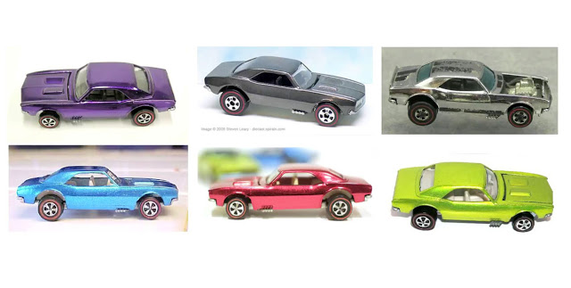
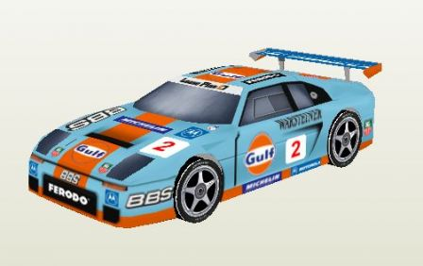
“Top 10” things you need to know and do
Like your car
The day you bring it home
Daily needs
Weekly needs
Occasional needs

Slide 9
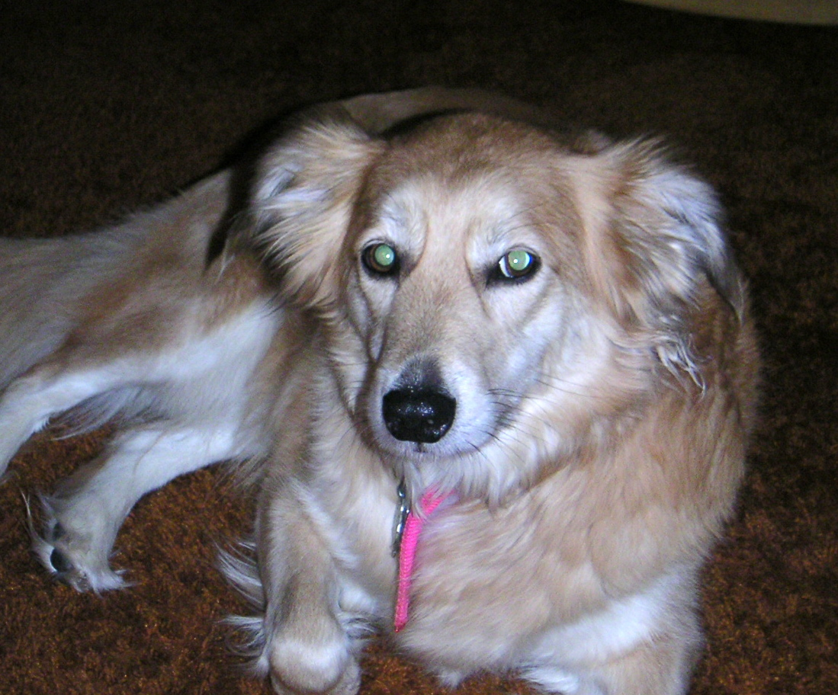
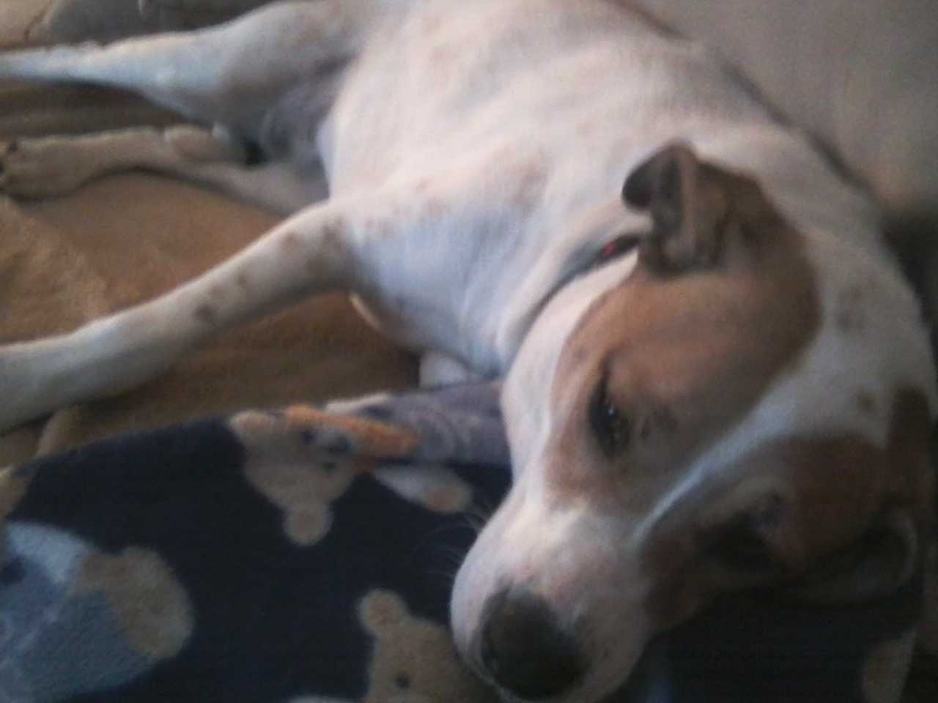
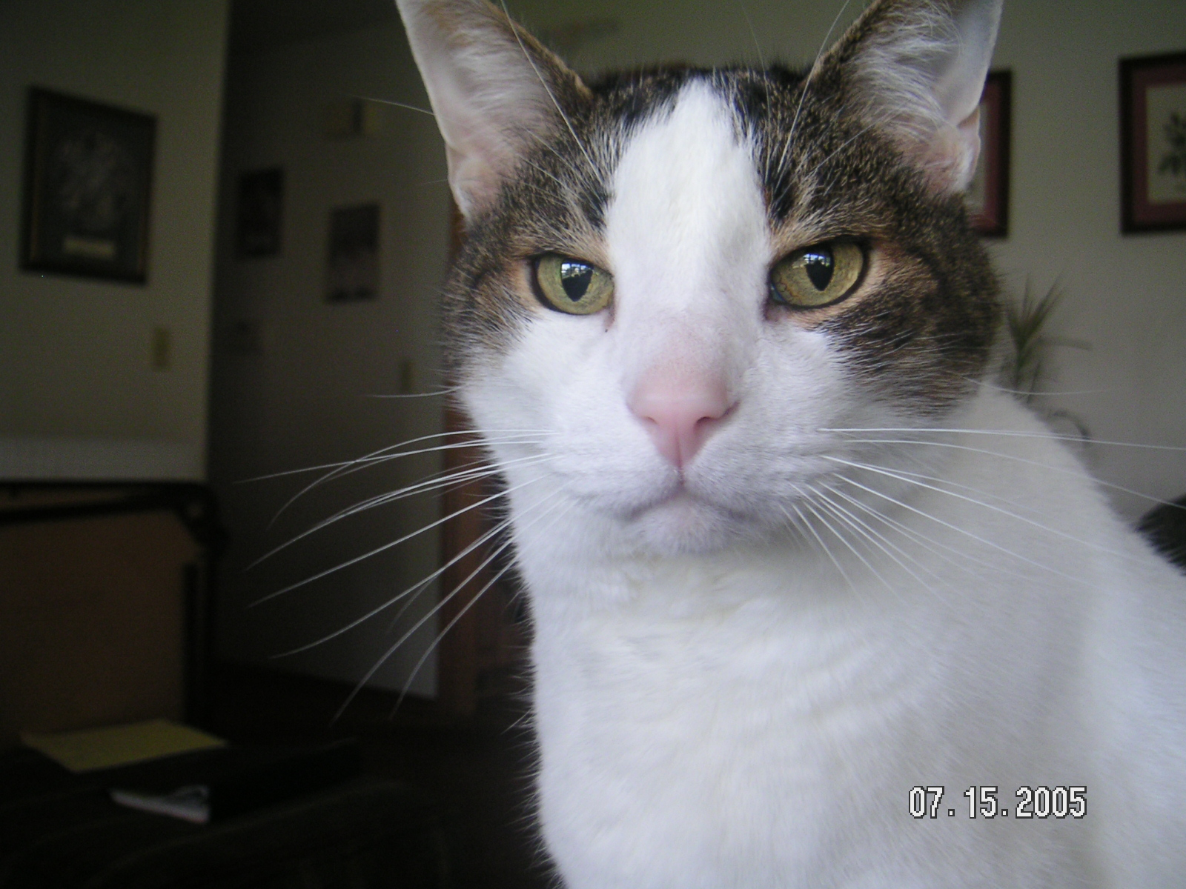
“Top 10” things you need to know and do
Like your pets
The day you bring it home
Daily needs
Weekly needs
Occasional needs

Slide 10



“Top 10” things you need to know and do
Like your Personal Relationships
The day you bring “it” home
Daily needs
Weekly needs
Occasional needs

Slide 11

“Top 10” things you need to know and do
What are the “Top 10”?
Security policy
Configuration – Storage, Network, etc.
Backups
Paging and Spooling space
Performance
Virtual Machine management
Logging
Social factors
Maintenance (applying service)
Handling outages – Disaster Recovery, abends

Slide 12
“Top 10” things you need to know and do
  Initial System Setup or Planning for Changes
  Everyday Items
  Occasional Items
  Prepared Responses to Catastrophic Events

Slide 13

“Top 10” things you need to know and do
Change Installation Passwords
z/VM and many products deliver with common passwords
These absolutely need to be changed
  Passwords for other installed products
Before moving your system into production, you should ensure all passwords conform to your corporate security policies.
  It can be embarrassing or worse
Other Material
  CP Planning and Administration manual **
Notes:
FIELD EXAMPLE – During hot problem customer didn’t know password, IBM rep suggested common password which worked

Slide 14
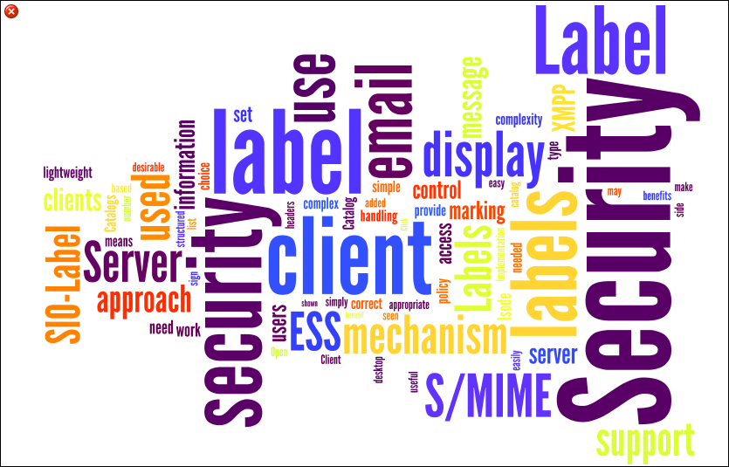
“Top 10” things you need to know and do
System Security Policy
System Security is very broad and means different things to different enterprises
  Passwords, Rules, Access Control, Granularity …
  External Security Manager (e.g. RACF/VM)
    NOTE: Adding an ESM to an existing SSI cluster is difficult. It is possible to do this after implementation of an SSI but you are better to do this before implementing SSI
  ESMs provide password encryption
Common Criteria Certification by z/VM
  A fully defined system
  It may be too much for you but it gives good ideas
Other Material
  z/VM: Secure Configuration Guide Manual **
  VM V6.3 Achieves Common Criteria Certification http://www.vm.ibm.com/security/
Notes:
Reference - Brian

Slide 15

“Top 10” things you need to know and do
Storage Configuration (FICON DASD and FCP SCSI)
Have a plan or work toward a plan for your storage configuration
  Current needs and growth
  Types of Storage
Storage Allocation and Maintenance
  Allocation (Standardization on Size and Device numbers) across LPARS
  Settings and Error reporting
  Duplicate VOLSER issues
  Cylinder zero is special sometimes
  (1-END Minidisk to protect the VOLSER and allocation)
  Advanced Configurations (e.g. GDPS)
Notes:
Deflect questions to more knowledgeable people – Steve W.
Also, it would be good to eventually have a Good/Better/Best chart after this chart.

Slide 16
“Top 10” things you need to know and do
Storage Configuration (FICON DASD and FCP SCSI)
Other Material
  CP Planning and Administration Manual **
  EREP in System Operations Manual **
  GDPS References and description page –
  http://www-03.ibm.com/systems/z/advantages/gdps/

Slide 17
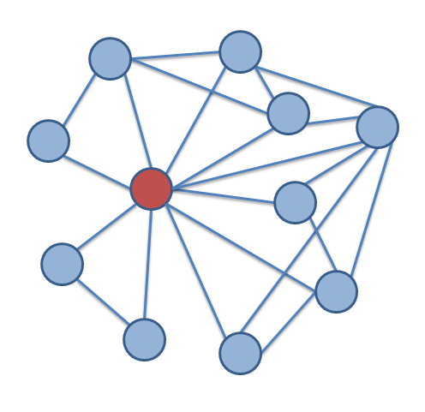
“Top 10” things you need to know and do
A Planned Network Configuration
Your physical and logical network for z/VM is key to nearly everything
  Server and Application Connectivity
  Transaction time and Perceptions
  Robustness – Built-in failover
  VSwitch and VSwitch Link aggregation is preferred
    Lower CPU costs
    Operates in Ethernet (Layer 2) or IP modes (Layer 3)
    Supports port isolation
    Supports link aggregation
  Involve your network team!! This is really a must
Other Material
  z/VM Connectivity Manual **
  z/VM: Getting Started with Linux on System z **
  Linux on System z Tuning Hints and Tips for
  Networking – http://www.ibm.com/developerworks/linux/linux390/perf/
Notes:
Deflect questions to more knowledgeable people - Alan

Slide 18

“Top 10” things you need to know and do
BACKUP of z/VM and Server data
Sometime and for some reason you will need to restore data on your system. Plan on this from the beginning
  Storage Failures
  Application failures
  ...
How
  Backups of key data – File level backup (including to email) or Device level
  Don’t backup unnecessary things (paging volumes, redundant SSI data, etc.)
  Being able to rebuild data
  Where to backup the data to is of your choice
  Duplicate copies of data (Flash Copy or otherwise)
  Consistent USABLE data. (with I/O Quiesced)
  TEST YOUR BACKUPs!!!!!
CP DATA
  SPXTAPE for Spool and System Data files
  DDR for CP Volumes (allocation maps etc.)

Slide 19
“Top 10” things you need to know and do
BACKUP of z/VM and Server data
Other Material
  z/VM: Getting Started with Linux on System z **
  Backup and Restore Manager for z/VM **
  Tape Manager for z/VM **
  SPXTAPE and DDR in the CP Commands Manual **
  DFSMS/VM publications in the VM Library for Tape Handling **
  Tivoli Storage Manager (now: IBM Spectrum Protect) **

Slide 20
“Top 10” things you need to know and do
  Initial System Setup or Planning for Changes
  Everyday Items
  Occasional Items
  Prepared Responses to Catastrophic Events

Slide 21
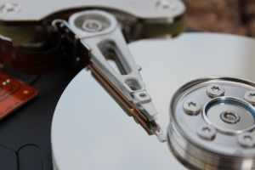
“Top 10” things you need to know and do
Manage Paging space on the system
Paging space is user and system pages on External Storage
  These pages can be a copy of what is in storage or the only copy
  Usage has changed in z/VM 6.3.0
  Planning your paging allocation is important
Paging space is not optional
  Running out of paging will cause a System Outage (PGT004 abend)
  Messages issued by CP at 90% & 100% also at 90% of spooling space in use as a last effort
    Often the messages come too late for must systems
  Monitoring over time will give you a good indication
  Commands and Tooling to watch and monitor PAGE
    QUERY ALLOC PAGE
Notes:
PGT004 ABENDs.. Nothing more to be said here…..

Slide 22
“Top 10” things you need to know and do
Manage Paging space on the system
Good – Periodic QUERY ALLOC PAGE to see where the system is regarding PAGE usage
Better – Queries but also maintaining the history of usage so you can see trends and EXECs to monitor specifics
  OMEGAMON can track history of Page Space Utilization
Best – An automated solution like Operations Manager that will both visually provide the state and will Notify you if some threshold has been exceeded.
  Catch the problem as it is changing in real time.

Slide 23
“Top 10” things you need to know and do
Manage Paging space on the system
Other Material
  CP Planning and Administration manual – Estimation **
  Operations Manager for z/VM -
  http://www-03.ibm.com/software/products/en/operations-manager-for-zvm

Slide 24

“Top 10” things you need to know and do
Keep track of System & Server Performance
System performance is about a number of things
  Monitoring System Performance
  Monitoring Guest Performance
  Making Improvements and knowing what those changes did
    Best to have performance data before and after changes are made
    Make one (or a very few changes) and measure
  Predict what is next
Things you can do
  Commands may help but overall they do not give a good holistic picture of performance (e.g. INDICATE)
  Collect Monitor Records – Even if you have a Performance Product you should save the data with MONWRITE
  Use analysis products

Slide 25
“Top 10” things you need to know and do
Keep track of System & Server Performance
Good – Periodic Commands to keep a pulse on the state of the running system.
  Maintain some history
Better – Queries and a performance product like Performance Toolkit and Tivoli OMEGAMON
Best – A holistic approach
  Automation via Performance product
  Collection of MONWRITE data at least
  Periodically and Before / After significant change
  Catch the problem as it is changing in real time.
Notes:
We could potentially expand this chart with more examples.

Slide 26
“Top 10” things you need to know and do
Keep track of System & Server Performance
Other Material
  CP Planning and Administration manual – Estimation **
  Tivoli OMEGAMON XE on z/VM and Linux
  http://www-03.ibm.com/software/products/en/tivoomegxeonzvmandlinu
  Collecting MONWRITE Data: About as Simple as I Can Make It by Brian Wade http://www.vm.ibm.com/devpages/bkw/monsimp.html
  MONCLEAN on the z/VM Download page **
  Redbook - The Virtualization Cookbook for IBM z/VM 6.3, RHEL 6.4, and SLES 11 SP3 – Section 23.3.1 http://www.redbooks.ibm.com/redbooks/pdfs/sg248147.pdf
  z/VM: Performance Toolkit Guide Manual **
  http://www-01.ibm.com/support/knowledgecenter/SSB27U_6.3.0/com.ibm.zvm.v630.hcpl8/toc.htm

Slide 27
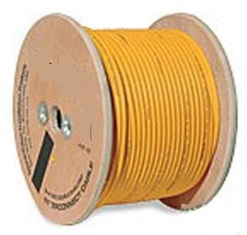
“Top 10” things you need to know and do
Manage Spooling space on the system
Spooling space in a z/VM system is required for normal operation
  Shared Segments - NSS / DCSS – Usually are not a problem
  Console Files – Logs from z/VM service machines
  Files being moved from one user to another and diagnostic data
Spool has a tendency to grow
  Aged unprocessed files
  Occasional Data -- DUMPS, Trace files, etc.
  Commands and Tooling to watch and monitor SPOOL
    QUERY ALLOC SPOOL
  CP Messages come really late for most installations
  Page Space Overflow (Last effort paging space)
  You need to have a System Operator for notifications

Slide 28
“Top 10” things you need to know and do
Manage Spooling space on the system
Good – Periodic QUERY ALLOC SPOOL to see where the system is regarding SPOOL usage
  Allocate Dedicated DUMP space
  QUERY DUMP
Better – Queries but also maintaining the history of usage so you can see trends
  Run tools like SFPURGER & SPOOLPIG to determine more information
  OMEGAMON will keep spool History
Best – An automated solution like Operations
Manager that will both visually provide the state but
will Notify you if some threshold has been exceeded
  Operations Manager can also run SFPURGER on a schedule or when thresholds have been reached
  Catch the problem as it is changing in real time.
Notes:
FIELD EXAMPLE – RSCS not working which prevented FTP jobs to z/OS from running. Found out that spool space ran out, breaking RSCS

Slide 29
“Top 10” things you need to know and do
Manage Spooling space on the system
Other Material
  CP Planning and Administration manual **
  SFPURGER – CMS Commands and Utilities manual **
  Operations Manager for z/VM -
  http://www-03.ibm.com/software/products/en/operations-manager-for-zvm
  SPOOL PIG and others – z/VM Download Page **

Slide 30
“Top 10” things you need to know and do
Monitor your Virtual Machines
Monitoring Virtual Machines (Servers) is often needed if anyone else is working with the system
  Two Types of servers (at least)
    Service Virtual Machines like those shipped with z/VM tend to be relatively stable but even they can change
    Linux Servers (Production or Test) tend to have transparent changes. (e.g. Workload, Configuration, z/VM definition etc)
  Servers tend to grow over time
  Knowing what is running will allow you to anticipate
Things that you can monitor
  QUERY NAMES – About the simplest
  INDICATE
    Working Set Sizes
    Resident Pages
    CPU Consumed
  Remember – some changes may not take effect until the server is restarted, which might not occur for a long time
Linux
Guests
Linux
Guests
Linux
Guests
Linux
Linux
Virtualized
resources
in LPARs
z/VM +
IBM Wave for z/VM
LPAR
LPAR
LPAR
LPAR
LPAR
I/O and Network
Physical
resources
IFLs
Memory

Slide 31
“Top 10” things you need to know and do
Monitor your Virtual Machines
Other Material
  CP Planning and Administration manual **
VIR2REAL – Compute the Virtual to Real storage (memory) ration of running users in a z/VM LPAR – z/VM Download Page **
Tivoli OMEGAMON XE on z/VM and Linux **
Linux
Guests
Linux
Guests
Linux
Guests
Linux
Linux
Virtualized
resources
in LPARs
z/VM +
IBM Wave for z/VM
LPAR
LPAR
LPAR
LPAR
LPAR
I/O and Network
Physical
resources
IFLs
Memory

Slide 32

“Top 10” things you need to know and do
Capture Important Console logs
z/VM servers have valuable information in their console logs. However, you need to capture it.
  Startup data is often captured in logs
  Logs contain a significant amount of mundane information
  Critical error information
  Only guests that are logged (could be disconnected) on to the system have logs.
  Should get at least a couple of days & initialization (more is better)
  Gathering the logs can be done by various methods
    Spooled Console Logs
    Automated logs to Disk
    Automation Products that do much of this for you
    TERM TIMESTAMP ON – Adds a time to each entry
Notes:
Note that “z/VM servers” mostly refers to Service Virtual Machines and Linux Servers.

Slide 33
“Top 10” things you need to know and do
Capture Important Console logs
Good – Ensure that Spooling of logs is enabled on all servers.
  Spooling – Set up with COMMAND statement in users Directory Entry
  Logging in a profile or server start-up
Better – Monitor Spooling of logs on periodic basis.
  Close/Purge oldest and open new Console Spool or log keeping newest.
  EXECs that may use FOR command to remotely do this
Best – An automated solution like Operations
Manager will automatically save and manage server machine consoles and logs, and optionally notify you of critical events
  Operations Manager VIEWCON tool allows for real time viewing of events that may also make management easier

Slide 34
“Top 10” things you need to know and do
Capture Important Console logs
Other Material
  The basics on gathering a Console log in the z/VM Diagnosis guide at: http://www-01.ibm.com/support/knowledgecenter/SSB27U_6.3.0/com.ibm.zvm.v630.hcpc1/clog.htm?lang=en
  Operations Manager for z/VM **

Slide 35

“Top 10” things you need to know and do
Mainframe Social -
Be Social – This is not a full time task but it really can help
  Watch what is being done by others
  Contribute your own thoughts and ideas
  Ask Questions
  Walking around – Virtually or Physically
There art a lot of avenues for material
  List Servers, Web groups (IBMVM and
  LINUX-390 LISTSERVs for questions,
  advice, lessons learned, answers, banter, etc.)
    Available 24 / 7 / 365
    Relatively low traffic, low spam, little bad advice
    Friendly, helpful, potential for lasting contacts
Other Material
  VM Community
  http://www.vm.ibm.com/techinfo/forums.html

Slide 36
“Top 10” things you need to know and do
  Initial System Setup
  Everyday Items
  Occasional Items
  Prepared Responses to Catastrophic Events

Slide 37


“Top 10” things you need to know and do
Changing SYSTEM CONFIG – As safely as possible
SYSTEM CONFIG
  Defines your system configuration
  On PMAINT CF0 in 6.3.0
Develop a process for changes and stick to it. Suggested steps:
  Make a backup copy before changing anything. This backup can be used in an emergency from the SAPL panel. Save backup in a place you can access in an emergency
  Have a peer review your changes
  Without fail, run CPSYNTAX !!!
Changes not effective until next IPL
(errors may not be discovered for months!)
Notes:
Reference – Tim G. pitch

Slide 38
“Top 10” things you need to know and do
Changing SYSTEM CONFIG – As safely as possible
CPSYNTAX Utility verifies that the SYSTEM CONFIG file is at least syntactically correct.
  A system programmer’s best friend!
  Available on the MAINT 193 minidisk
  An easy way to avoid embarrassing mistakes at IPL or worse
  Easy to run – Catches incorrect and
  unrecognized statements
    Even Comment Changes
  Corrupted SYSTEM CONFIG file problems
  can be very ugly and can take a long time to fix
Notes:
Reference – Tim G.

Slide 39
“Top 10” things you need to know and do
Changing SYSTEM CONFIG – As safe as possible
Other Material
  CPSYNTAX Described in the CP Commands Manual **
  CP Planning and Administration manual **

Slide 40

“Top 10” things you need to know and do
Review Startup Logs for errors
Start-up console logs may reveal errors or problems
  Even if a server or application starts successfully there can be issues.
  Error messages, Warnings & overrides should be reviewed
Critical times for reviewing logs.
  New Releases
  Maintenance of server or application
  Common Error messages that could be missed
    DASD Problems Duplicate VOLID or Offline
    Spool Problems (e.g. NSS/DCSS …)
    CONFIG ERRORs
Other Material
  CP Messages and Codes Manual **
  Other Server manuals
  …

Slide 41

“Top 10” things you need to know and do
Maintenance is not something that can wait forever
Have a strategy to apply z/VM maintenance at least twice a year
    Maybe when the clocks change for Daylight Saving time
    RSU’s for z/VM are the items that we Recommend ordering / applying
    Keep up to date no matter what your future plans are
Just because you are ready does not mean that activating the maintenance is always required.
    Prepare through testing 2nd level
  Urgent Service – Red Alerts and Hiper APARs
Notes:
Be ready for backlash – no set schedule!

Slide 42
“Top 10” things you need to know and do
Maintenance is not something that can wait forever
Apply Recommended Service Upgrade (RSU):
  Released Periodically (6 months give or take)
  Contains cumulative service including all pre and co-requisites in a pre-built format
  Includes service for all integrated components and pre-installed program products
  Available on 3590 tape, DVD, or electronically (servlink envelope)
  Includes service required by most customer installations
  RSUs are proven, tested, and selective
Easy to install:
  SERVICE
  PUT2PROD
Easy to remove or back out
  SAPL – IPL from CPLOLD MODULE
  VMSES/E - VMFREM

Slide 43
“Top 10” things you need to know and do
Maintenance is not something that can wait forever
Other Material
  RSU Page – as needed. See: http://www.vm.ibm.com/service/rsu/
  Alert Page -- A great place to watch for the most important items.
  To Subscribe: http://www.vm.ibm.com/service/redalert/
  News -- http://www.vm.ibm.com/service/news
  RSU Buckets and other maintenance is still Important
    http://www14.software.ibm.com/webapp/set2/psearch/search?domain=psp

Slide 44

“Top 10” things you need to know and do
What is the future – Longer range
Systems will change over time
  Server changes (maintenance or workload changes)
  Data Changes
  END of Service -- End of currency UPDATE
  http://www.vm.ibm.com/techinfo/lpmigr/vmleos.html
Environmental changes
  CEC changes What else is being utilized on CEC
  Storage changes
  Network changes
Growth Changes
  Additional Consolidation is a good thing but there
  are limits
Notes:
Ask what release they are running.

Slide 45
“Top 10” things you need to know and do
  Initial System Setup
  Everyday Items
  Occasional Items
  Prepared Responses to Catastrophic Events

Slide 46
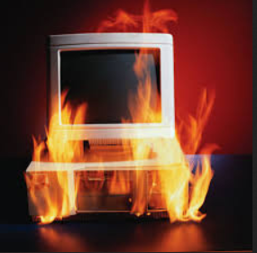
“Top 10” things you need to know and do
Disaster Recovery
Review/Develop your Disaster Recovery (DR) strategy
  DR is important in ALL environments
  DR procedures must be adjusted for SSI members
    DR site and Home site needs to be the same. A multi-member Home needs multi-member DR or use REPAIR MODE.
    VM65358 (still Open) will make this better by providing the new CLEARPDR IPL parameter on the SAPL panel.
  Some Planning now will help later
Disaster is not well defined but I am sure
you will know when you experience one
  TEST Your DR Plans
Notes:
GDPS anyone? If so, we can talk DR offline.

Slide 47
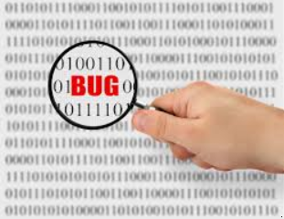
“Top 10” things you need to know and do
Prepare for z/VM Failures
CP does not often fail but that does not mean that you should not be ready for an event
  CP Abends – When CP discovers an unrecoverable error and Dumps
  Incorrect Output – user is stuck in CP (hung), detected by user, etc.
  It is Very Rare – CP HANG
The goal is to Get the System Running and gather as much data as possible
  IMPORTANT: Reserve dedicated dump space -
  DUMP option on CP_Owned statement

Slide 48
“Top 10” things you need to know and do
Prepare for z/VM Failures
Dump types, methods, and behavior
  CP abend – Dump taken and system IPLs automatically
  SNAPDUMP command – Dump taken, system stays up. However, system is quiesced which may adversely affect servers.
  PSW RESTART from the HMC. Dump taken and system IPLs automatically. Resultant dump appears as an SVC002 abend dump.
  VMDUMP command – Dump of a virtual machine’s storage. Usually only requested by server support groups, but could be requested by us if it is for a second level VM system.
WARNING: Straight “LOAD” of CP from the HMC
will just IPL CP and NOT produce a dump! For
all hangs, use PSW RESTART!!
CP dumps written to OPERATNS reader
(default)

Slide 49
“Top 10” things you need to know and do
Prepare for z/VM Failures
Learn how to process a CP dump
  DUMPLOAD or DUMPLD2 utility
    DUMPLD2 enables you to create a multi-file dump, which is easier to transfer to IBM
Collect the OPERATOR’s console from the time of failure
Practice moving files to and from z/VM (even copy/paste to email)
Nearly every problem diagnosis starts with
the same questions:
  Description?
  Release and service level?
  What Changed (Workload, Service, HW, …) ???
Notes:
“WHAT CHANGED?” Field examples:
Nothing changed – except RSU applied last weekend
Nothing changed – further inquiries uncovered another abend, hardware change, and falling ceiling tiles on the HW in question

Slide 50
“Top 10” things you need to know and do
Prepare for z/VM Failures
Other Material
  z/VM: Diagnosis Guide **
  Software Support Handbook http://www14.software.ibm.com/webapp/set2/sas/f/handbook/home.html
  z/VM Service Resources http://www.vm.ibm.com/service/

Slide 51

“Top 10” things you need to know and do
Your own education and that of your peers
Education is an ongoing process
  THANK YOU for your interest in attending this presentation and furthering your education
  Please continue this ongoing effort
  Assisting a peer will make vacations much more enjoyable ☺
Types of education
  Workshops and Tech Conferences
  Formal and informal classes
  OJT and/or reading manuals or Redbooks
Other Material
  CP Planning and Administration manual **
  Running guest Operating System manual **
  Getting Started with Linux Manual **
  The z/VM Education Page http://www.vm.ibm.com/education/
  Redbooks http://www.redbooks.ibm.com/

Slide 52

More Information

Slide 53
Common References **
zVM Manuals in the Knowledge center for z/VM V6.3
http://www-01.ibm.com/support/knowledgecenter/SSB27U_6.3.0/com.ibm.zvm.v630/zvminfoc03.htm
  VM V6.3 Achieves Common Criteria Certification http://www.vm.ibm.com/security/
  VM Download Page http://www.vm.ibm.com/download/
  RSU Page – as needed http://www.vm.ibm.com/service/rsu/
  Alert Page -- A great place to watch for the most important items
  To Subscribe: http://www.vm.ibm.com/service/redalert/
  z/VM: Performance Toolkit Guide Manual
  http://www-01.ibm.com/support/knowledgecenter/SSB27U_6.3.0/com.ibm.zvm.v630.hcpl8/toc.htm
  VM Service News http://www.vm.ibm.com/service/news
  RSU Buckets and other maintenance is still Important
  http://www14.software.ibm.com/webapp/set2/psearch/search?domain=psp
GDPS Reference page
http://www-03.ibm.com/systems/z/advantages/gdps/
  Operations Manager for z/VM
  http://www-03.ibm.com/software/products/en/operations-manager-for-zvm
  Tivoli OMEGAMON XE on z/VM and Linux
  http://www-03.ibm.com/software/products/en/tivoomegxeonzvmandlinu
  Tivoli Tivoli Storage Manager (now: IBM Spectrum Protect)
  http://www-03.ibm.com/software/products/en/tivostormana
  z/VM Glossary
  http://www-01.ibm.com/support/knowledgecenter/SSB27U_6.3.0/com.ibm.zvm.v630.hcpb9/glossary.htm?lang=en
  z/VM Migration Guide
  http://www-01.ibm.com/support/knowledgecenter/SSB27U_6.3.0/com.ibm.zvm.v630.hcpf2/toc.htm?lang=en

Slide 54
For More Information …
Web sites:
  http://www.vm.ibm.com/ -- zVM on the Web
  http://www.vm.ibm.com/library -- the online zVM Library
  http://www.vm.ibm.com/education -- presentations, classes and information
Via mailing lists:
  IBMTCP-L@VM.MARIST.EDU
  IBMVM@LISTSERV.UARK.EDU
  LINUX-390@VM.MARIST.EDU
Contact Information:
Tim Reynolds
z/VM CP Level 2 Support
timr@us.ibm.com
Acknowledgement: Thanks to Steve Wilkins, Bill Bitner, and Dan Griffith from IBM z/VM Development for helping put this presentation together.

Slide 55
Dank u
Dutch
Merci
French
Спаcибо
Russian
Gracias
Spanish
شكراً
Arabic
감사합니다
Korean
Tack så mycket
Swedish
धन्यवाद
Hindi
תודה רבה
Hebrew
Obrigado
Brazilian
Portuguese
谢谢
Chinese
Dankon
Esperanto
Thank You
ありがとうございます
Japanese
Tak
Danish
Trugarez
Breton
Danke
German
Grazie
Italian
நன்றி
Tamil
ขอบคุณ
Thai
děkuji
Czech
go raibh maith agat
Gaelic

