Slide 1
Big Data, Hadoop and data integration with System z
Mike Combs — Veristorm
mcombs@veristorm.com

Slide 2
The Big Picture for Big Data

Slide 3
The Big Picture for Big Data
“The Lack of Information” Problem
“The Surplus of Data” Problem
1 in 3
“The 3 V’s” of Big Data
  Volume: More devices, higher resolution, more frequent collection, store everything
  Variety: Incompatible Data Formats
  Velocity: Analytics Fast Enough to be Interactive and Useful
Business leaders frequently make decisions based on information they don’t trust, or don’t have
1 in 2
Business leaders say they don’t have access to the information they require to do their jobs
83%
Of CIOs cited “Business Intelligence and Analytics” as part of their visionary plans to enhance competitiveness
60%
Of CIOs need to do a better job capturing and understanding information rapidly in order to make swift business decisions
(Doug Laney, Gartner Research)

Slide 4
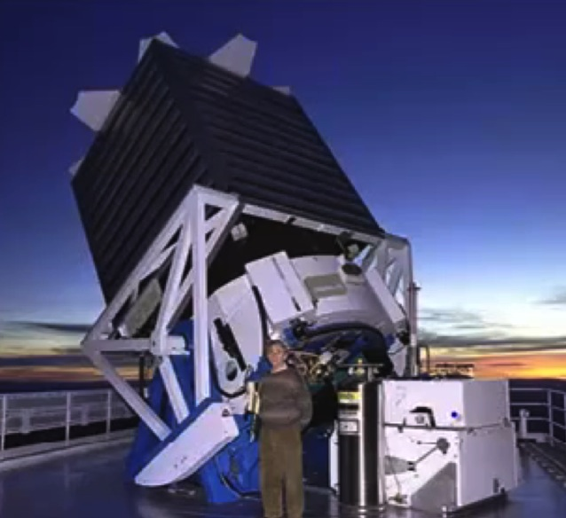
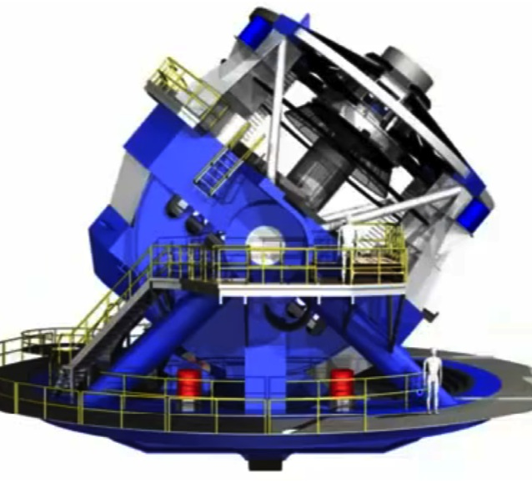
Big Data: Volume
SDDS telescope, 80 TB in 7 years
LSST telescope, 80 TB in 2 days

Slide 5
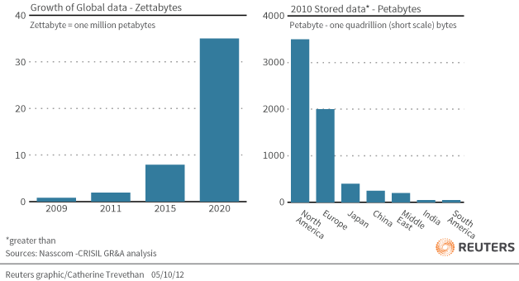
Big Market, Big Growth

Slide 6
Big Data: Variety
20% is “Structured”
80% is “Unstructured”
Tabular Databases like credit card transactions and Excel spreadsheets
Web forms
Pictures: Photos, X-rays, ultrasound scans
Sound: Music (genre etc.), speech
Videos: computer vision, cell growing cultures, storm movement
Text: Emails, doctor’s notes
Microsoft Office: Word, PowerPoint, PDF

Slide 7
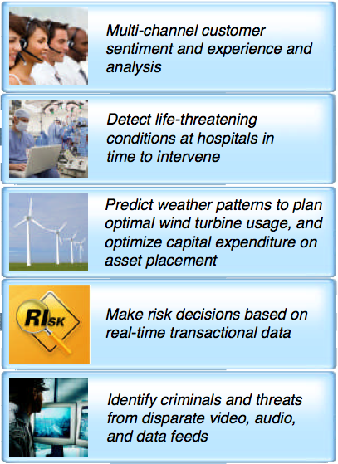
Big Data: Velocity
To be relevant, data analytics must timely
Results can lead to new questions; solutions should be interactive
Information should be searchable

Slide 8
Increasing needs for Detailed Analytics
Baselining & Experimenting
  Parkland Hospital analyzed records to find and extend best practices
Segmentation
  Dannon uses predictive analytics to adapt to changing tastes in yogurt
Data Sharing
  US Gov Fraud Prevention shared data across departments
Decision-making
  Lake George ecosystem project uses sensor data to protect $1B in tourism
New Business Models
  Social media, location-based services, mobile apps
Notes:
5 basic value models for big data identified by McKinsey Group.

Slide 9


Big Data Industry Value
Finance and Insurance
~1.5 to 2.5 percent annual productivity growth
$828 billion industry

Slide 10






What is Hadoop and Why is it a Game Changer?
Hadoop solves the problem of moving big data
  Eliminates interface traffic jams
  Eliminates network traffic jams
  New way to move Data
Hadoop automatically divides the work
  Hadoop software divides the job across many computers, making them more productive
Without Hadoop
Bottleneck
Notes:
Apache Hadoop is an open-source software framework that supports data-intensive distributed applications. It is designed to run on large clusters of commodity hardware. Hadoop framework is designed more for batch processing rather than interactive use by users. So the emphasis is on high throughput of data access.
Above the file systems is the MapReduce engine, which consists of one JobTracker, to which client applications submit MapReduce jobs. The JobTracker pushes work out to available TaskTracker nodes in the cluster, striving to keep the work as close to the data as possible.

Slide 11
Hadoop Projects & Ecosystem
Hue
SQL GUI
Lucene/Solr
Search
Pig
Scripting
Hive
SQL
Sqoop
DB import
Ambari
Deploy, configure, monitor
Oozie
Orchestration, workflow
ZooKeeper
Configuration, coordination
HCatalog
(optional) Schema sharing
HBase
Column DB
MapReduce/Tez on YARN
Distributed processing framework
Flume
Log import
HDFS
Distributed, redundant file system
Notes:
See the TDWI Research Report: Integrating Hadoop into BI/DW, Q213

Slide 12
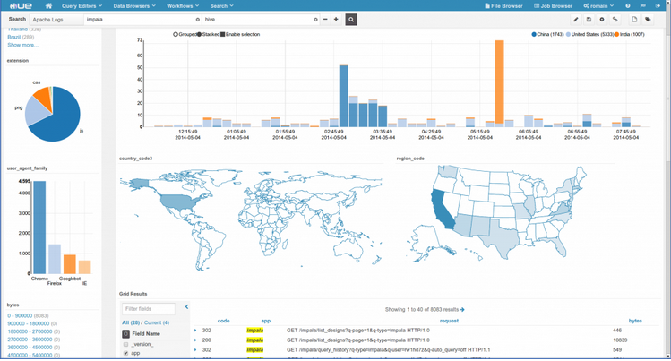
Hue
HUE

Slide 13
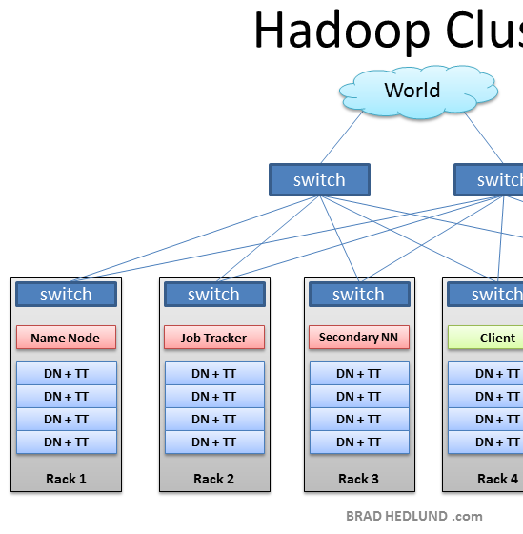
Typical Hadoop Cluster
NameNode
  Files, metadata in RAM, logs changes
Secondary NameNode
  Merges changes. Not a backup!
JobTracker
  Assigns nodes to jobs, handles failures
Per DataNode
  DataNode— Files and backup; slave to NameNode
  TaskTracker— Manages tasks on slave; slave to JobTracker

Slide 14
Hadoop “hello world”

Slide 15
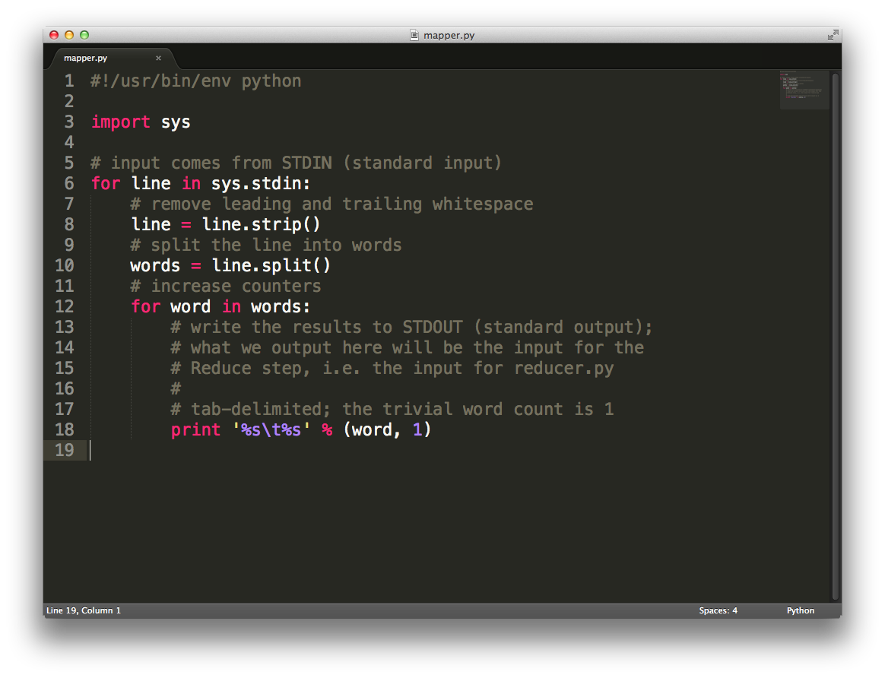
Mapper.py

Slide 16
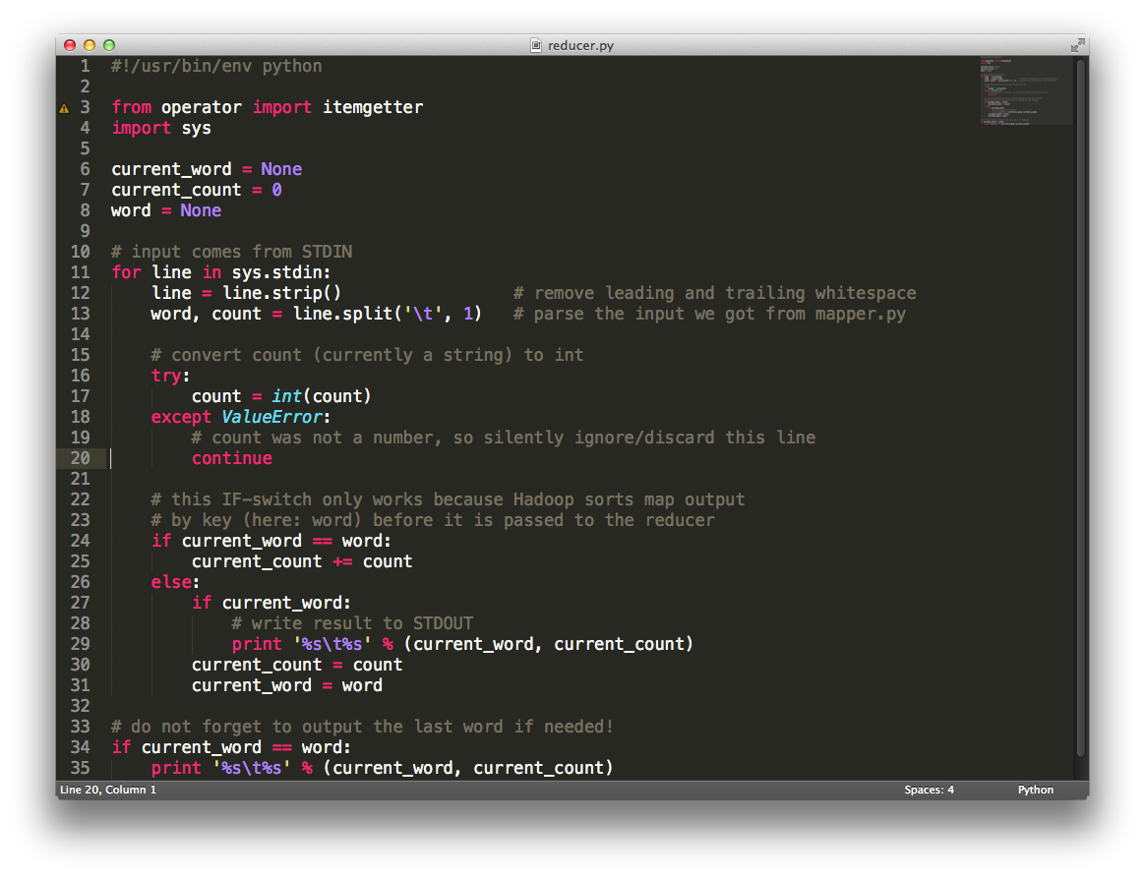
Reducer.py

Slide 17
Big Data Today

Slide 18
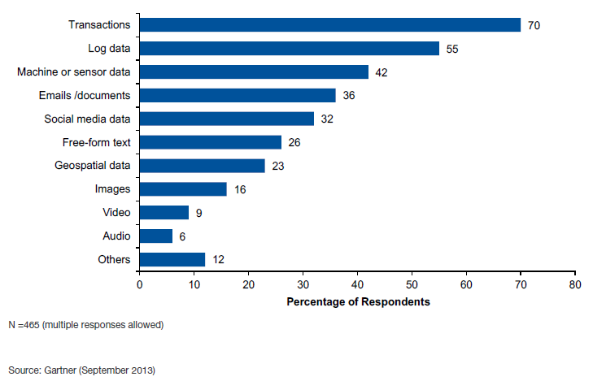
Today’s Big Data Initiatives: Transactions, Logs, Machine Data
Unstructured data
Notes:
So where do you start? Do you stop every thing and tell the world “We are doing Big Data projects from now on.”? No. In reality you have been doing Big Data for many years - particularly if you have the System z mainframe – but the scope is widening beyond the trusted data that you use within your DB2 for z/OS, IMS transaction processing, data warehousing, Cognos.
When you hear the term big data many people and organizations immediately think or emails, social media, machine to machine data, etc but in a recent Gartner Big Data survey , when businesses were asked what was the dominant data type being analysed in big data initiatives the response was replied TRANSACTIONS , Log Data – followed by sensor /machine to machine and emails.

Slide 19
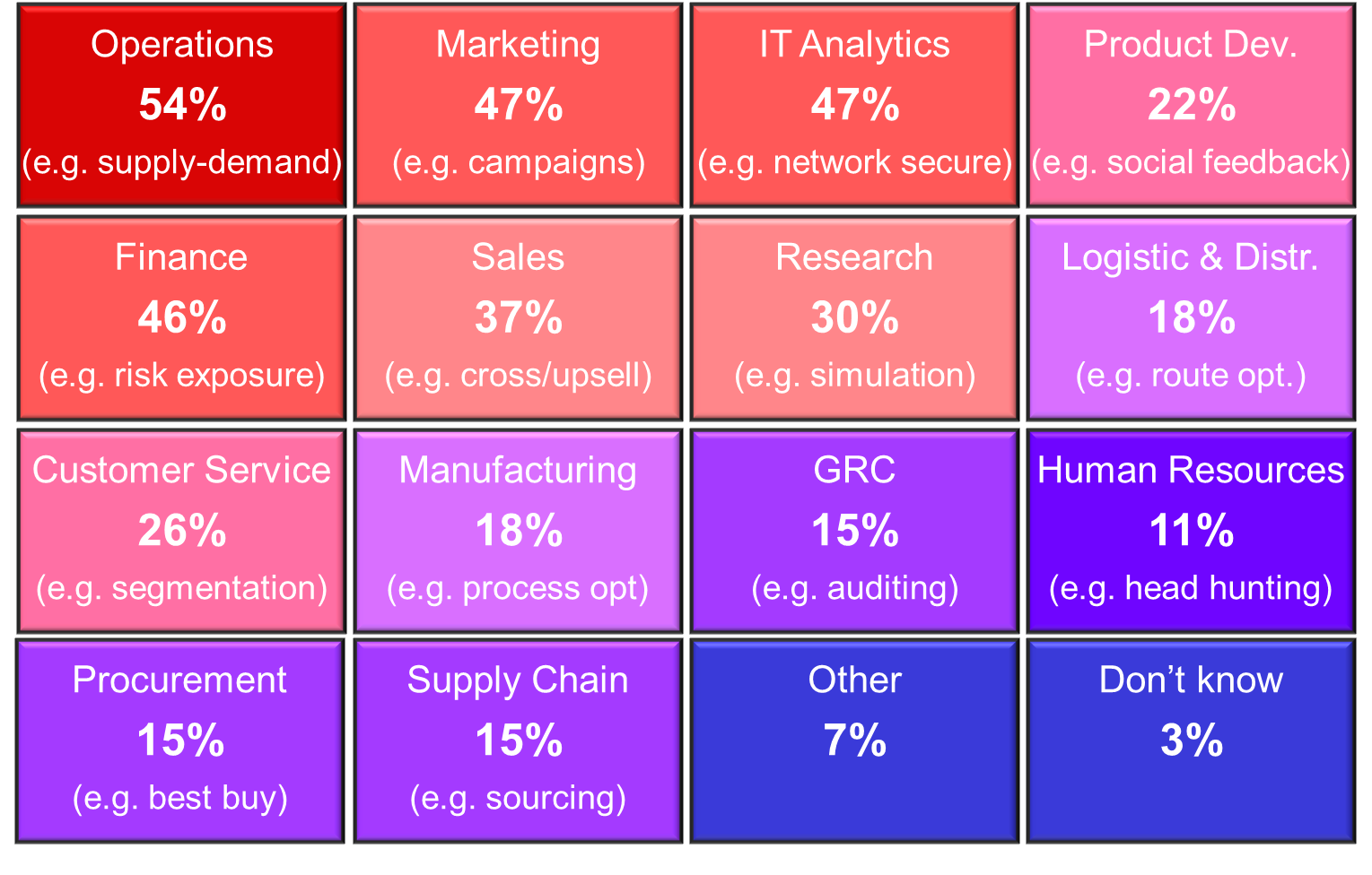
IT leads Big Data usage.. but departments are catching up...
“What groups or departments are currently using Big Data/planning to use Big Data?”
Source: Forrsights BI/Big Data Survey
Base: 176 big data users and planners

Slide 20
Transaction Data = Mainframe Computers
IBM’s Academic Initiative
  1000 higher education institutions
  In 67 nations
  Impacting 59,000 students
However, mainframe data uses proprietary databases which must be translated to talk to formats familiar in “Big Data”
Mainframes run the global core operations of
  92 of top 100 banks
  21 of top 25 insurance
  23 of top 25 retailers
Process 60% of all transactions
Mainframe computers are the place for essential enterprise data
  Highly reliable
  Highly secure
Notes:
IBM invented the Mainframe 50 years ago and it continues to be the infrastructure of choice for large enterprise information.
The mainframe utilizes proprietary languages (databases) that need to be "translated" into current languages in order to be integrated and utilized.
The mainframe continues to be very important to world infrastructure due to its ability to crunch numbers and tables with the highest reliability of any computing machine. For instance:
IBM mainframes run the core operations of:
92 out of the top 100 global banks (perhaps an explanation of ATM, credit card data?)
21 out of the top 25 global Insurance firms (explanation?)
23 of the top 25 worldwide retailers (same here)
Veristorm's market opportunity is the top 5000 largest global organizations
70% of all global enterprise information is on mainframe computers
Vibrant growth among new generation of mainframe needs
IBM's academic initiative - 1,000 higher education institutions in 67 countries are using the IBM mainframe Academic Initiative, enabling 59,000 students to various courses
We should put something here about our video, where IBM pimps us at MF50
IBM's new mainframe focus is CAMS (cloud, analytics, mobile and social).
Our zDoop product enables IBM to use the mainframe as an integrated analytics computer, whereas previously they needed to off-load the information, now they can perform the analytics on the mainframe. This is where we're integrating our products with theirs.

Slide 21



The ROI Behind the Hype
The most relevant insights come from enriching your primary enterprise data
System z Mainframe
Semi-public,
Unstructured
Sensitive,
Structured
Call center data,
Claim Systems,
Social,…
Customers, Transactions, ...
Notes:
The most valuable insights are the ones you get before your competition gets them
This is likely to come from the data you have that is unique to your customer relationships
The power of big data is in performing analytics on the fully detailed data, not aggregates or averages
Semi-public data are things like twitter, facebook
Gmail is semi-private. Google analyzes it to tune ads to the users, but the email is not published.
This data may not fit into rows and tables… it could be photos, videos
Primary data: Customer/core/enterprise, private enterprise data
Center things around your customer

Slide 22
Integration Problem For Data Scientists
Enterprise data analysts require near-realtime mainframe data
Mainframe users wish to off-load batch processes to Hadoop for cost savings
“Survey Analysis - Big Data Adoption in 2013 Shows Substance Behind the Hype”, Gartner, 2013, Link
of the dev effort in a big data project goes into data integration
“By most accounts
80%
20%
goes towards data analysis.”
…and only
“Extract, Transform, and Load Big Data With Apache Hadoop”, Intel, 2013, Link

Slide 23
Can We Increase Agility?
Today, mainframe data is integrated via ETL
  LOB owner defines report
  Negotiates implementation
  IT creates application
  LOB owner evaluates report
Slow, not agile
Transformation on mainframe is costly
Defined Apps
Manual Integration
Manual
Extraction
IBM Mainframe
DB2
QSAM
VSAM
IMS
Logs
Stock, ATM, Credit cards, Insurance
Patient records
Performance, capacity and app planning

Slide 24
Analytics Solution Model (Banking)
Top Down
Card Abandonment
Fraud Detection
Product, Price, Promotion, Place
Customer Segmentation
Real-time Credit Scoring
Machine Learning
Sentiment Analysis
Simulation
Transactions
Web logs
Forums, Trouble tickets
Advertising

Slide 25
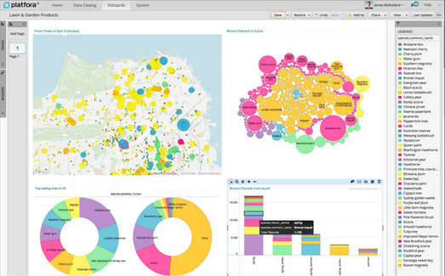

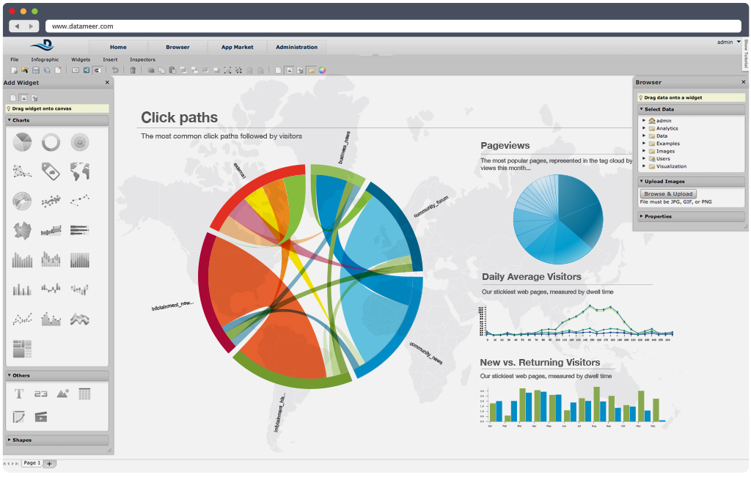


Self Service, Top Down

Slide 26
Implementation
Search
z/OS
DB2 tables &
VSAM files
DB2
Reports
IDMS
Datacom
Data and metadata transfer
VSAM
IMS
Transformation
Compliance/Lineage
Apps
Logs
System z
Cloudera

Slide 27
Faster!
Hadoop’s agility benefits for enterprise data
  Hadoop’s flexible data store (structured, unstructured, binary) slashes schema complexity
  Data pulled by data scientist, closer to LOB owner
  No ETL project
  Near real-time data movement
  Shorter iterations

Slide 28
Mainframe Integration

Slide 29
Obstacles to Include Mainframe Data
1/ Data Governance as the data moves off z/OS operational systems
2/ Data Ingestion from z/OS into Hadoop (on or off platform) is a bottleneck (MIPS & ETL cost, Security around data access and transfer, Process Agility)
Lead to key requirements:
Existing security policies must be applied to data access and transfer.
There needs to be high speed / optimized connectors between traditional z/OS LPARs and the Hadoop clusters
Ability to serve data transparently into Hadoop clusters on mainframe AND on distributed platform
Notes:
29
29

Slide 30

Data Ingestion Challenges
DB2
Extract from proprietary formats.
Aggregate or summarize.
Transform
VSAM
IMS
Load
Logs
Staging
z/OS
JCL, DB2, HFS, VSAM, IMS, OMVS, COBOL Copybooks, EBCDIC, Packed Decimal, Byte ordering, IPCS, z/VM, Linux on z
Hadoop, MongoDB, Cassandra, Cloud, Big Data Ecosystem, Java, Python, C++, Interface skills
Notes:
Traditionally offloading data for analytics is complex
First, you must collect from the database. This could be COBOL or SQL work… and consultants and delay
Second, often to preserve privacy, the data is anonymized and a summary is exported, not the detail data
Without detail data, you’re missing the whole point of Hadoop
However you export the data, it is staged and then transformed. This could be a change to the code-point (EBCDIC to Unicode) or change to XML.
A secure Hadoop cluster must be configured.
Finally it is loaded into HDFS.
The delay decreases agility and increases costs.
Aggregation decreases the possibilities and accuracy of later analytics.

Slide 31
vStorm Enterprise – Mainframe data to Mainstream
vStorm Enterprise
No Staging!
z/OS
Linux
Linux
Linux
DB2
IDMS
Hive
Datacom
VSAM
IBM BigInsights
Cloudera
Hortonworks
MapR
IMS
Logs
zDoop
VDH
VDH
System z
Power Systems
x86
Veristorm Data Hub (VDH)
Notes:
Veristorm’s vStorm Enterprise consists of two capabilities, both of which run exclusively on Linux on IBM System z:
• vStorm Connect –a set of native data collectors that uses a graphical interface to facilitate the movement of z/OS data to Hadoop
• zDoop –the industry's first commercial, fully supported implementation of the open source Apache Hadoop project Linux on System z
vStorm Enterprise is proving to be quite efficient. Veristorm worked with us to run a series of tests that demonstrated solid scalability, and as I mentioned earlier their 2-2-2 test demonstrated agility in driving a representative workload. But the real value of Veristorm’s product comes from how being able to run Hadoop directly on System z addresses some of the most critical needs of mainframe shops.
A secure pipe for data
Virtually all mainframe files and logs have the same degree of sensitivity as operational relational data, and therefore require the same governance and security models. Transmitting such sensitive data over public networks, to racks of commodity servers, breaks those governance and security models and puts data at risk of compromise. On on-platform solution keeps data within the confines of the mainframe in order to meet compliance challenges without adding the complexity of coordinating multiple governance and security zones or worrying about firewalls.
vStorm Enterprise is fully integrated with the z/OS security manager, RACF, so there is no need to establish unique and potentially inconsistent credentials to use vStorm Enterprise; security is built-in, right out of the box.
Keeping mainframe data on the mainframe is a critical requirement for many clients, and zDoop enables Hadoop analysis of mainframe data without that data ever leaving the security zone of the mainframe.
Easy to use ingestion engine
vStorm Connect simplifies the transfer of data from z/OS to Hadoop without the end user having to be concerned with outdated file types, COBOL copybooks, or code page conversions; and since it runs in Linux on System z it facilitates that transfer efficiently without driving up the load on the z/OS environment.
Templates for agile deployment
One of the hardest tasks in managing a Hadoop analysis project is sizing the clusters. Underestimate and the project must be put on hold until capacity is added. Commodity servers may be cheap, but they still have to be procured, inserted into the data center, configured, loaded with software and made known to the Hadoop management system. Overestimate and unused capacity sits idle, negating the perceived cost benefit of using commodity infrastructure in the first place.
This is not a very agile or friendly process – if you’re in an environment where your analytics needs are likely to change frequently, you will struggle to keep capacity in line with processing requirements.
vStorm Enterprise, running on the mainframe, executes within a fully virtualized environment. It offers – out of the box – templates so that new virtual servers can be added to the Hadoop cluster with just a few basic commands (or via automation software). This is a true cloud environment where users can obtain and return capacity on demand to suit their needs.
Mainframe efficiencies
Security, simplicity, and agility are the true hallmark value propositions of vStorm Enterprise for analyzing mainframe data. But there are also some basic efficiencies that arise simply from running Hadoop in a scale-up (mainframe) vs scale-out (commodity) environment.
Most notably, consider that Hadoop – to compensate for the unreliability of commodity storage and compute nodes, by default triplicates all data for availability purposes. At some volume, all of this extra storage and associated maintenance undercuts the economics of using Hadoop on commodity systems. Running Hadoop with the quality of a mainframe underneath it can prove to be more economical in the long run because there is very low risk in running with a single copy of the data. And it can greatly simply I/O planning by removing bottlenecks.

Slide 32
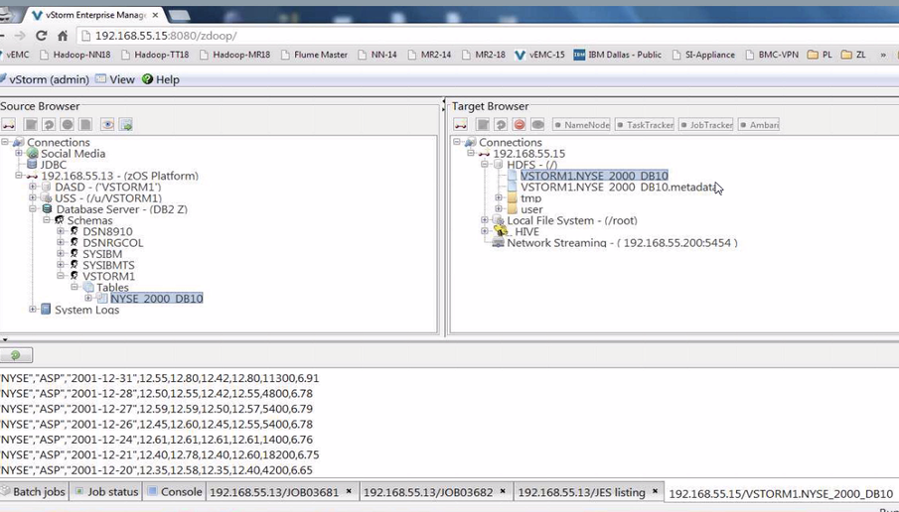
Select HDFS or Hive destination for copy
Select source content on z/OS
Browse or graph content

Slide 33
Use Cases

Slide 34

Financial Services Use Case
Problem | Solution | Benefits
High cost of searchable archive on mainframe $350K+ storage costs (for 40TB) MIPS charges for operation $1.6M+ development costs due to many file types, including VSAM 2000+ man-days effort and project delay | Move data to Hadoop for analytics and archive Shift from z/OS to IBM Linux (processors) on z to reduce MIPS Use IBM SSD storage Use IBM private cloud softlayer Tap talent pool of Hadoop ecosystem | Reduction in storage costs Dev costs almost eliminated Quick benefits and ROI New analytics options for unstructured data Retains data on System z for security and reliability

Slide 35

Health Care Use Case
Problem | Solution | Benefits
Relapses in cardiac patients “One size fits all” treatment $1M+ Medicare re-admission penalties Sensitive patient data on Mainframe No efficient way to offload and integrate | Identify risk factors by analyzing patient data* Create algorithms to predict outcomes | 31% reduction in re-admissions $1.2M savings in penalties No manual intervention No increase in staffing 1100% ROI on $100K
* Mainframe database requires special skills to access without Veristorm
Notes:
Insights from Big Data are projected to be worth $300 billion in US health care sector
Common use case
Huge savings/ efficiencies possible from analyzing patient data
Regulations around offloading from secure platform
Prevents efficient/ affordable Big Data Analytics

Slide 36

Public Sector Use Case
Problem | Solution | Benefits
Mismanaged assets led to neighborhood, publicity, law & order issues Post-2008 austerity measures reduced budget Asset data was Mainframe based – no efficient offload and integration mechanism | “Crowd source problem” reporting – cell phone photo, social media, GPS data Integrate social media reports with asset / governance data on Mainframe, achieving regulation conformity | Software cost of $400K compares to $2M consulting engagement Better maintained neighborhoods yield $5.6M in higher taxes first year
* System z IMS database requires special skills to access without vStorm

Slide 37

Retail Use Case
Problem | Solution | Benefits
Streams of user data not correlated e.g. store purchases, website usage patterns, credit card usage, historical customer data Historical customer data Mainframe based – no efficient, secure integration | Secure integration of historical customer data, card usage, store purchases, website logs Customer scores based on the various data streams High scoring customers offered coupons, special deals on website | 19% increase in online sales during slowdown Over 50% conversion rate of website browsing customers Elimination of data silos – analytics cover all data with no more reliance on multiple reports / formats

Slide 38
Unlock New Insight and Reduce Cost
Do More
  Analyze large amount of information in minutes
  Offload batch processes to IFLs to meet batch window requirement
Reduce Cost
  Take advantage of IFLs price point to derive more insight
Application extensibility achieved through newly available skillset

Slide 39
White Papers and Articles
“The Elephant on z”,
IBM & Veristorm, 2014
  www.veristorm.com/go/elephantonz
“Bringing Hadoop to the Mainframe”,
Paul Miller, Gigaom, 2014
  www.veristorm.com/go/gigaom-2014
“Inside zDoop, a New Hadoop Distro for IBM’s Mainframe”,
Alex Woodie, Datanami, 2014
  www.veristorm.com/go/datanami-2014-04
“vStorm Enterprise Allows Unstructured Data to be Analyzed on the Mainframe”,
Paul DiMarzio, 2014
  www.veristorm.com/go/ibmsystems-2014-06
“vStorm Enterprise vs. Legacy ETL Solutions for Big Data Integration”,
Anil Varkhedi, Veristorm, 2014
  www.veristorm.com/go/vsetl
“Is Sqoop appropriate for all mainframe data?”,
Anil Varkhedi, Veristorm, 2014
  www.veristorm.com/go/vssqoop
IBM Infosphere BigInsights System z Connector for Hadoop
  www.ibm.com/software/os/systemz/biginsightsz
    (Includes data sheet, demo video, Red Guide)
Solution Guide: “Simplifying Mainframe Data Access”
  http://www.redbooks.ibm.com/Redbooks.nsf/RedbookAbstracts/tips1235.html

Slide 40
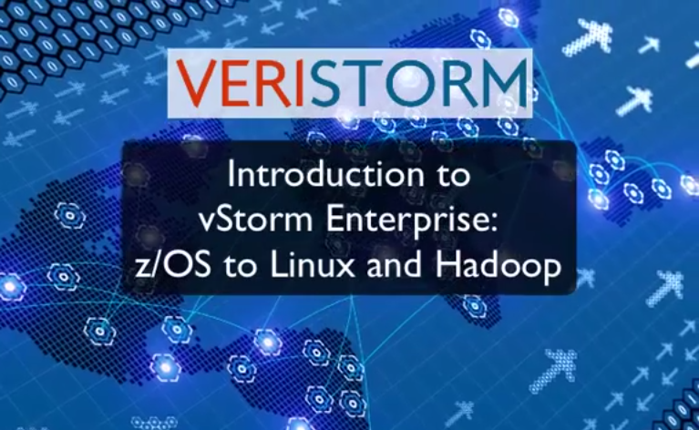
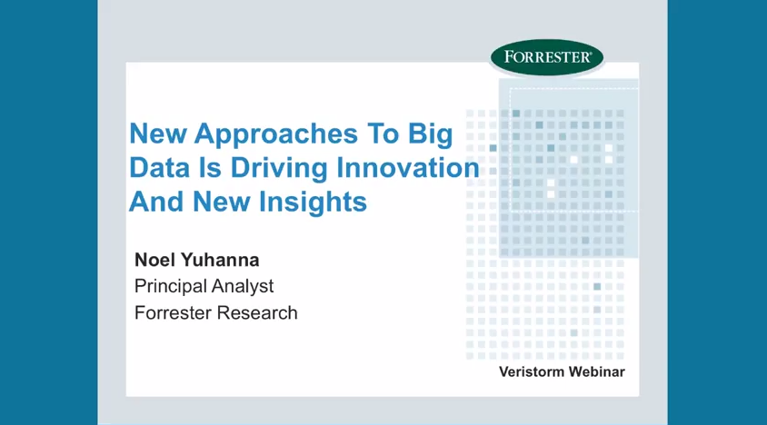
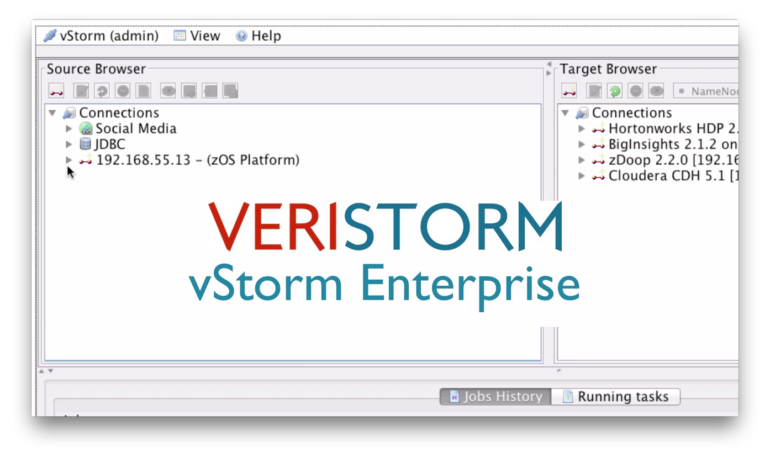
Videos
Introduction
Webinar
www.veristorm.com/go/introvid11m
www.veristorm.com/go/webinar-2014q3
Demo
www.veristorm.com/go/demovid2m

