Slide 1
RPM Basics
Dustin Harman
VM Workshop 2015

Slide 2
What is RPM?
Red Hat Package Manager
Native package manager on RHEL, Fedora, SUSE, some Mandriva
RPM/SRPM files contain binaries and/or source code

Slide 3
Why use RPM?
Software installation and removal
Configuration changes
Same packing process for source, script, binary, config files, other
For the end user

Slide 4
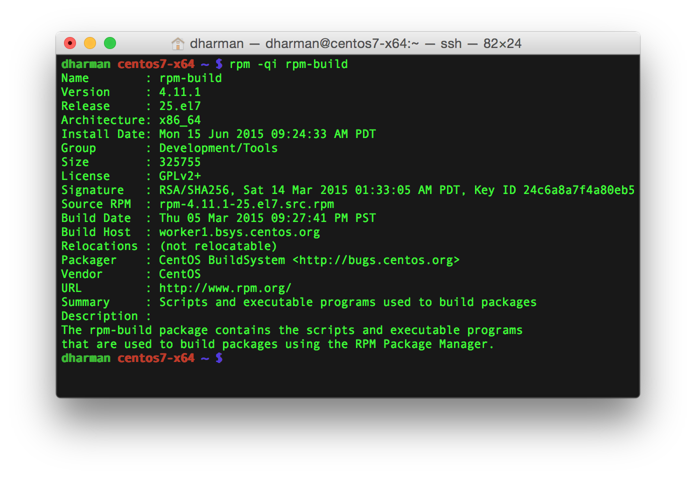
“rpm” command

Slide 5
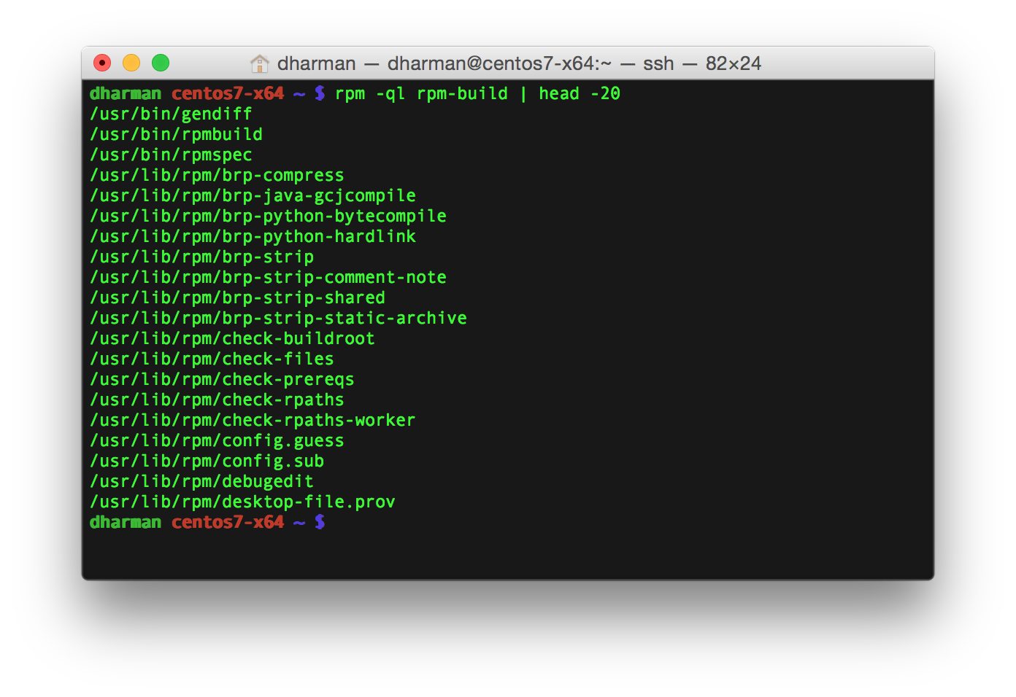
“rpm” command

Slide 6
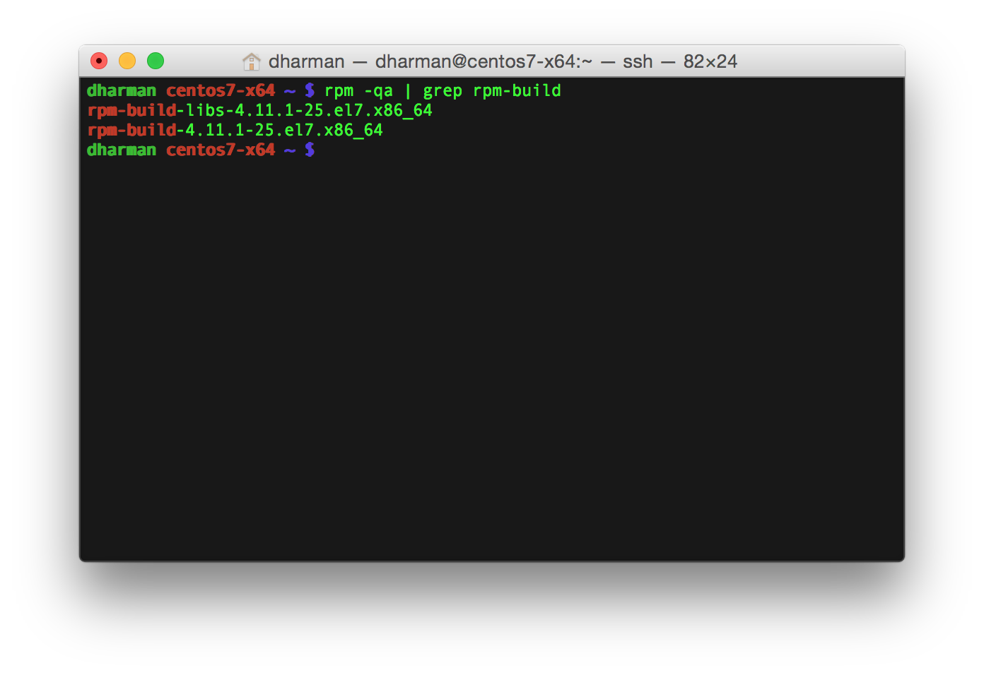
“rpm” command

Slide 7
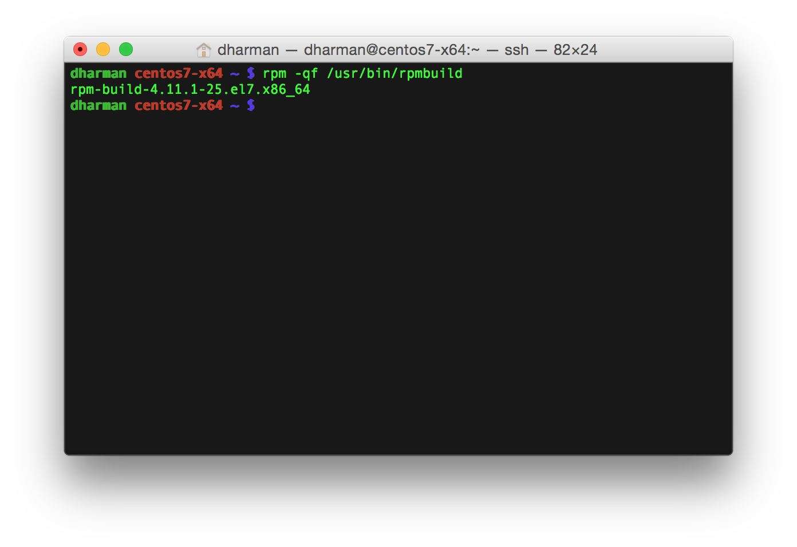
“rpm” command

Slide 8
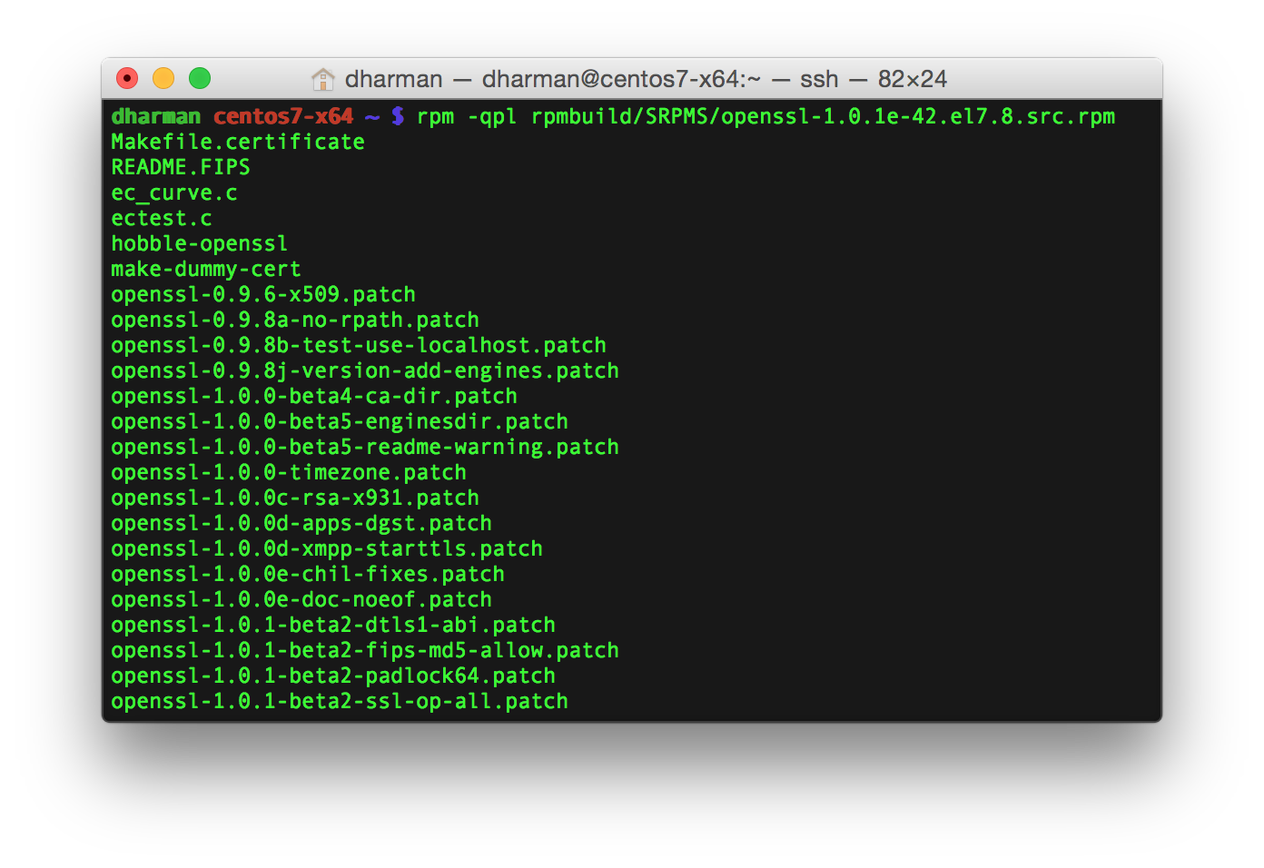
“rpm” command

Slide 9
Yum
Uses RPM and provides additional package management functionality
Install, delete, update, search, dependencies
Pointed at repositories (local or external)

Slide 10
RPM build setup
$ sudo yum install rpm-build redhat-rpm-config
$ sudo yum install rpmlint make gcc
$ mkdir -p ~/rpmbuild/{BUILD,RPMS,SOURCES,SPECS,SRPMS}
$ echo '%_topdir %(echo $HOME)/rpmbuild' > ~/.rpmmacros
$ echo '%packager First Last <user@example.com>' >> ~/.rpmmacros

Slide 11
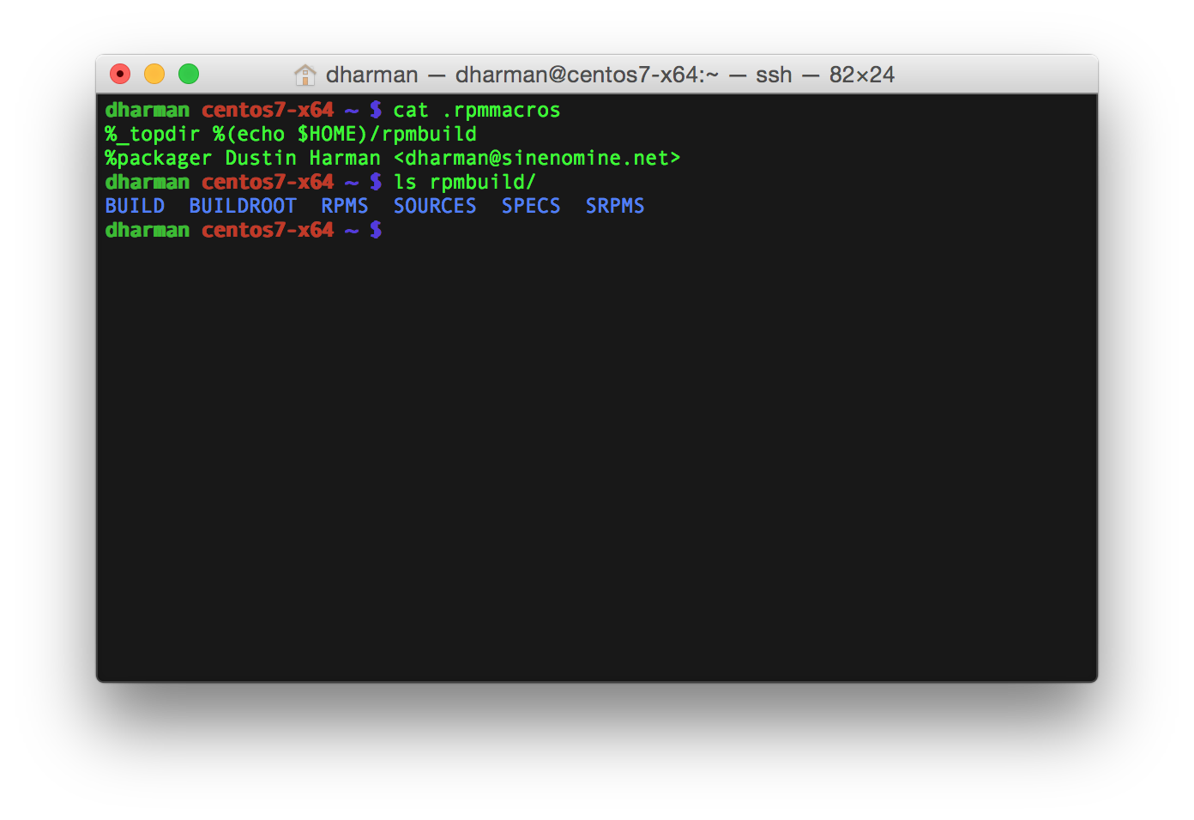
RPM build setup

Slide 12
RPM build directory
%_topdir (set via ~/.rpmmacros)
  SOURCES
  SPECS
  RPMS
    noarch
    s390x...
  SRPMS
  BUILD

Slide 13
Spec file
Tags
  Name, Version, Release, Summary
  Group, License, URL, SourceN, PatchN
  Requires, BuildRequires
  BuildRoot, BuildArch
Scripts
  %prep, %build, %install, %clean
Other
  %description
  %files
  %changelog

Slide 14
RPM Macros
%setup
%patchN
%configure
%{_bindir}...
%config,%config(noreplace)
%define

Slide 15
Conditionals
%ifarch s390x
%ifnarch s390x
%else
%endif

Slide 16
Generate patch files
$ cp -rp ./source ./source-new
[Make your changes to new source]
$ diff -ru ./source ./source-new >| ~/rpmbuild/SOURCES/source.patch
Patch1: source.patch
%patch1 -p0

Slide 17
“rpmbuild” command
rpmbuild -bs <specfile>
  Build source RPM
rpmbuild -bb <specfile>
  Build binary RPM
rpmbuild -ba <specfile>
  Build all RPMs (binary and source)
rpmbuild --rebuild <source rpm>

Slide 18
“rpmbuild” magic
Requires
Debuginfo packages

Slide 19
Debugging
Check the rpmbuild/BUILD directory
rpm --eval %macro
rpmlint

Slide 20
Compatibility issues
Third-party repositories
Mock
Hash algorithm changes

Slide 21
Yum Repository Creation
$ sudo yum install createrepo
$ createrepo /srv/example/repo
[examplerepo]
name = Example Repository
baseurl = file:///srv/example/repo/
baseurl = http://server/example/repo/

Slide 22
Recommended reading
rpm(8), rpmbuild(8), yum(8), createrepo(8)
Maximum RPM: www.rpm.org/max-rpm

Slide 23
Spec file walkthrough and demo

Slide 24
Questions?
dharman@sinenomine.net
https://www.sinenomine.net/contact-us

