Slide 1
Lessons Learned from:
Installing Second Level z/VM 6.3
Steps taken and roadblocks conquered
Kolu Jarboi
6/25/2015

Slide 2
For Informational Purposes Only
Terms of this Presentation
© 2015 CA. All rights reserved. All trademarks referenced herein belong to their respective companies. This presentation is intended for information purposes only and does not form any type of warranty. Some of the specific slides with customer references relate to customer's specific use and experience of CA products and solutions so actual results may vary.
Certain information in this presentation may outline CA’s general product direction. This presentation shall not serve to (i) affect the rights and/or obligations of CA or its licensees under any existing or future license agreement or services agreement relating to any CA software product; or (ii) amend any product documentation or specifications for any CA software product. This presentation is based on current information and resource allocations as of November 9, 2014 and is subject to change or withdrawal by CA at any time without notice. The development, release and timing of any features or functionality described in this presentation remain at CA’s sole discretion.
Notwithstanding anything in this presentation to the contrary, upon the general availability of any future CA product release referenced in this presentation, CA may make such release available to new licensees in the form of a regularly scheduled major product release. Such release may be made available to licensees of the product who are active subscribers to CA maintenance and support, on a when and if-available basis. The information in this presentation is not deemed to be incorporated into any contract.

Slide 3
Agenda
System Requirements
Installation Worksheets
Steps/Roadblocks

Slide 4
System Requirements
Installation ID | Any first level system administrator user ID
Current system | Access to INSTPIPE MODULE
Privilege classes | B and G
Virtual storage | 64M
Language | AMENG, UCENG, or KANJI
Minidisk 191 | Read/write access as file mode A
LINK to CMS minidisk that contains the VM deliverables.
Minidisk 2222 | 2222 RW 3390 10 cyl
Minidisk 24CC | 24CC RW 3390 10 cyl
Minidisk 2CF0 | 2CF0 RW 3390 10 cyl
Products | Installation and RSU tape
Page 74 of the z/VM Installation Guide
Notes:
Other languages (UCENG, AMENG (American English))
Choose based on region, policy of company
Note what it does and it all depends
Speak in the same order as the slide
Explain what each disk is for (2222, 24CC, 2CF0)
**Tape mounted, drive attached**

Slide 5
Installation Worksheets
Non-SSI
3390
First-Level Config
SSI
3390
FBA
Worksheets 1, 2, & 8
Worksheets 5 & 6
Worksheet 7
Worksheet 4
Worksheet 3
Notes:
SSI: Single System Image
Non-SSI because it has less resource requirements (particularly DASD), and given we did not have SSI
requirements we did not need the extra resources and set up.
FBA: Fixed Block Architecture
Notes:
SSI – Single System Image
FBA – Fixed Block Architecture
CKD – Count-Key Data

Slide 6
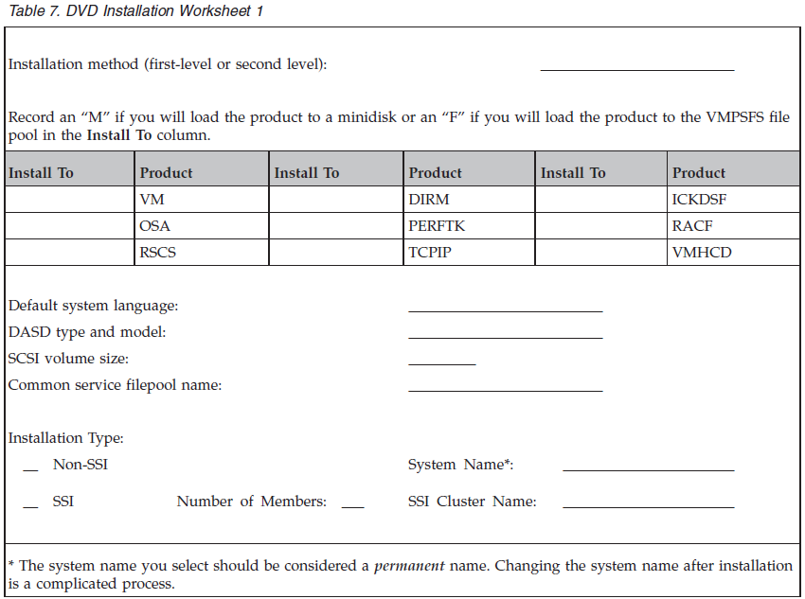
Worksheet 1
Notes:
Minidisk is easier to share when SFS (Shared File System) is not installed yet.
In our environment, it was just best to use minidisk.
Second level is vm under vm.
First level is vm on hardware.

Slide 7
Worksheet 1
Installation Method | Second Level
Will each product be loaded to minidisks or file pools? | Minidisk
Default System Language | AMENG
DASD Type and Model | 3390 Model 3
Common Service Filepool Name | VMPSYS3 (Normally VMPSYS)
Installation Type | Non-SSI
System Name | Sysname
Notes:
Minidisk is easier to share when SFS (Shared File System) is not installed yet.
In our environment, it was just best to use minidisk.
Second level is vm under vm.
First level is vm on hardware.

Slide 8
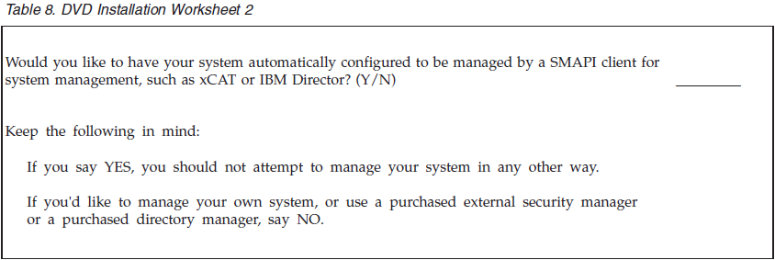
Worksheet 2
As an example
  For our system
    CA VM: Director and CA VM: Secure
Notes:
Directory management; used secure for directory manager (or VM: Director)

Slide 9
Worksheet 3
Volume Type
Default Label
New Label
Address
COMMON
COMMON2
RELVOL
RELVOL2
RES
SPOOL
PAGE
VMCOM1
VMCOM2
630RL1
630RL2
MO1RES
MO1SO1
MO1PO1
MO1WO1
MO1WO2
155
WORK
WORK
WORK
MO1WO3
15A
158
159
15B
150
151
152
153
154
Notes:
Note what each volume type is.

Slide 10
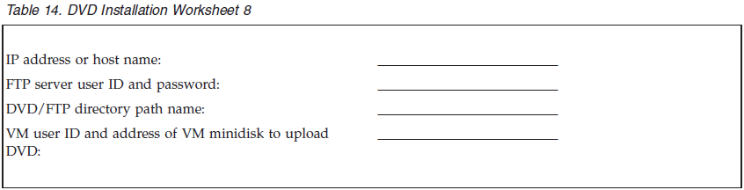
Worksheet 8
Notes:
Reword to say “If you are…..”

Slide 11
Steps 1 – 10
Step | Description | Command
1 | Logon already established test system | logon jarko01
2 | Link the disk with the INSTPIPE MODULE | link maintvrm 4cc vdev
3 | Access the disk with the INSTPIPE MODULE | acc vdev fm
4 | Copy a INSTPIPE MODULE over to the A disk/SFS directory | copy / = = a (olddate
5 | Grant authority to the INSTPIPE MODULE file | grant auth instpipe module a to sysname
6 | Log onto SYSNAME | logon sysname by userid
7 | Access the directory the INSTPIPE MODULE was copied to in step 4 | acc directoryName fm
8 | Access SYSNAME’s root directory as filemode A | acc . a
9 | Create a 191 minidisk | define t3390 as 191 10
10 | Prompt: Format 191? Make sure 191 is actually on the system | “Yes” q search
Notes:
Remove periods

Slide 12
Steps 11 – 20
Step | Description | Command
11 | Define a 2222 read/write minidisk | define t3390 as 2222 10
12 | Define a 24CC read/write minidisk | define t3390 as 24CC 10
13 | Define a 2CF0 read/write minidisk | define t3390 as 2CF0 10
14 | Spool the console to make sure it is empty, started and spooled to the reader | spool cons close start *
15 | Verify the 2222 disk is the right size | q v 2222
16 | Access the minidisk that contains the INSTPIPE MODULE as file mode C | acc diskAddr C
17 | Run INSTPIPE | instpipe
18 | Link to the CMS minidisk with the image files | link userid 17E 17E
19 | Access the minidisk linked in the previous step as file mode W | acc 17E w
20 | Decode, unpack, and write the files needed to run DVDPRIME to the 2222 minidisk | pipe dvddecod CKD222 image w |UNPACK| ECKDREST 2222
Notes:
Double check 16
Verify the sizes of all 3 disks

Slide 13
Steps 21 – 29
Step | Description | Command
21 | IPL CMS to remove the old INSTPIPE MODULE from storage | ipl cms
22 | Access the 191 minidisk as file mode A | acc 191 a
23 | View all INSTPIPE MODULE occurrences | filel instpipe module * (date
24 | Access the minidisk that contains the image files as file mode W | acc 17E w
25 | Access the 2222 minidisk as file mode C | acc 2222 c
26 | Verify the first occurrence of the INSTPIPE MODULE is on the minidisk accessed as C | filel instpipe module *
27 | Run DVDPRIME with the dasd type being installed | dvdprime 3390 (disk
28 | Access minidisk 24CC as file mode C | acc 24cc c
29 | Run INSTPLAN with the DVD operand | instplan DVD

Slide 14
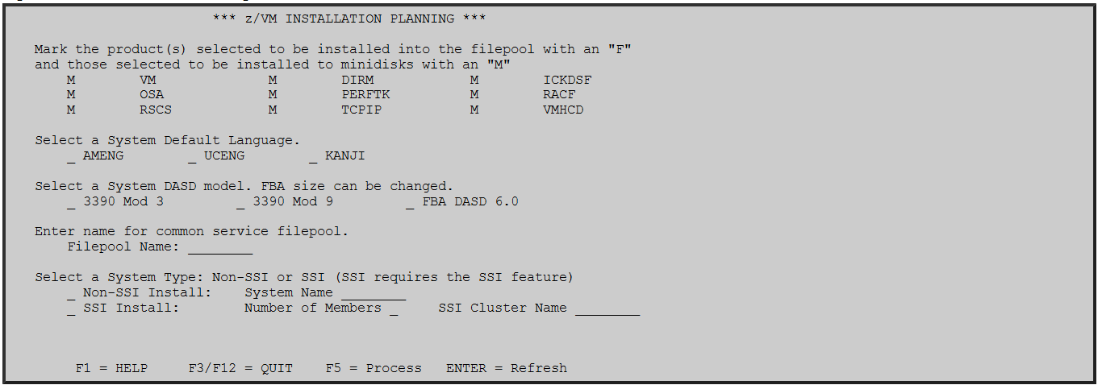
Installation Panel

Slide 15
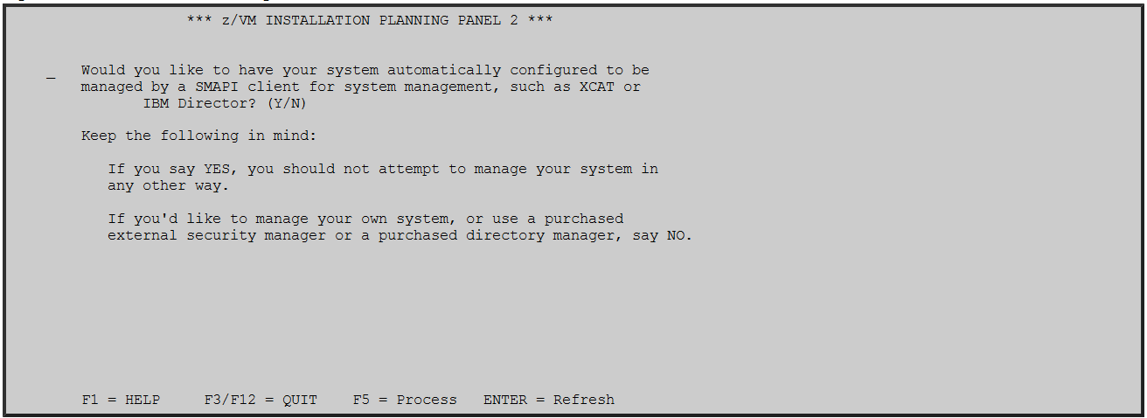
Installation Panel

Slide 16
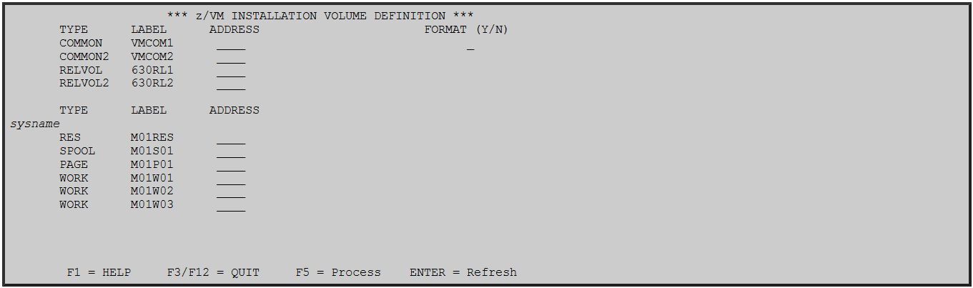
Installation Panel

Slide 17
Steps 30 – 37
Step | Description | Command
30 | Run INSTALL to install z/VM 6.3 | install
31 | Log onto MAINT630 | username: MAINT630 password: WD5JU8QP
32 | Shutdown the second level system | shutdown
33 | Log off of first level system | log
34 | Receive the latest RSU
35 | Follow the steps in the Service Guide | z/VM V6.3 Service Guide
36 | Edit the System Config file to include “User_Volume_List” | x system config
37 | CP format the installation volumes if not already formatted | CPFMTXA/ICKDSF
Notes:
Add screen shot of System Config file

Slide 18
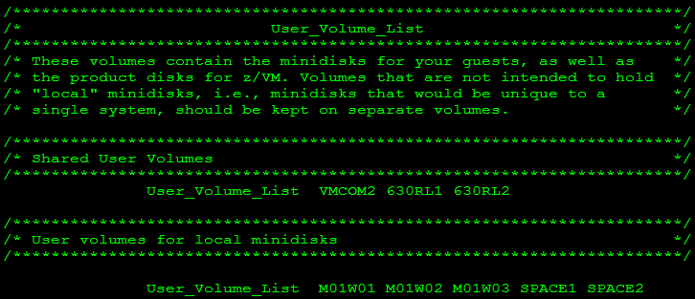
Sample System Config File

Slide 19
References
z/VM V6.3 CP Planning and Administration
z/VM V6.3 Service Guide
z/VM V6.3 Running Guest Operating Systems
z/VM V6.3 Installation Guide
z/VM V6.3 Other Components Messages and Codes
Device Support Facilities: User's Guide and Reference
z/VM V6.3 CP Commands and Utilities Reference
z/VM V6.3 VMSES/E Introduction and Reference
All of these documents can be found at http://www.vm.ibm.com/library/index.html
Notes:
Change titles to links

Slide 20
Questions?
CA Community Link for the VM: Manager Products
https://communities.ca.com/community/ca-mainframe-virtualization
Notes:
Reference all of the help I received and all of the help they can receive while being at the workshop.

Slide 21
Kolu Jarboi
Associate Software Engineer
Kolu.Jarboi@ca.com

