Slide 1
ADP - Customer Experience with Oracle on System z
Phil Tully
Chief Architect z/VM-z/Linux

Slide 2
Thanks
Special thanks for allowing me to “borrow” from their presentations and providing details for this one:
  Steve Conger :VP - Mainframe Systems Dev.
  Joe Comitini :Principal Architect - Infrastructure

Slide 3
ADP – Company Background
$11 Billion in annual revenue
52,000 Employees worldwide
ADP pays 1 in 6 U.S. workers
ADP pays 1 in 4 Canadian workers
Processed nearly 53 million W-2’s in 2014
We moved $1.5 trillion dollars electronically for our U.S. clients last year
Approximately 5 million people access ADP systems every day
Over 300,000 SaaS clients (18 million users) leveraging ADP’s solutions for recruiting, talent management, time and attendance, HR, benefits, retirement services, and payroll
Provide one or more services to 80% of the Fortune 500 and 90% of the Fortune 100 companies
ADP serves over 600,000 clients across 100 countries
Largest provider of HR services in North America, Europe, Latin America and the Pacific Rim

Slide 4
Mainframe Environments
Four data centers in North America
22 CEC’s
        Mix of z13’s, z/EC-12’s, z/196’s and z/BC-12
42 z/OS LPAR’s
        Consolidated into three data centers
        Payroll processing, retirement services, tax services & more
        52,000+ Programs – almost 60 million lines of code (mostly COBOL)
        4 million batch jobs processed each month
        Over 400 CICS regions supporting around 20 million transactions/day
Over 1,500 TB of CKD DASD for z/OS and z/VM

Slide 5
Mainframe Environments – z/VM / LINUX Details (June 2013)
Where we are today…June 2013
      Over 400 IFL’s
      > 300,000 MIPS installed and growing…
      28 z/VM LPAR’s and growing…
      More than 25 TB of Memory across 10 CEC’s (Active and Pre-planned)
      2,800 Guests and growing each week
      WAS, CSL, Oracle, Portal, Cognos, DB2 Connect, QMF, TEPS
      More than 6,800 JVM’s
      Over 1,600 Oracle Databases
      900+ TB of SAN attached disk
      Another 800+ TB of CKD disk
      Over 5,300 virtual CPU’s and 17 TB of virtual RAM

Slide 6
Mainframe Environments – z/VM / LINUX Details (Today)
Where we are today…April 2015
      Over 750 IFL’s (By mid-July - Over 800)
      > 640,000 MIPS installed and growing…
      56 z/VM LPAR’s and growing…
      More than 40TB of Memory across 14 CEC’s (Active and Pre-planned)
      3,900 Active Guests and growing each week (6000+ including DR)
      WAS, Tomcat, CSL, Oracle, Portal, Cognos, DB2 Connect, QMF, TEPS
      More than 11,000 JVM’s
      Over 3,500 Oracle Databases
      1,500+ TB of SAN attached disk
      Another 1,200+ TB of CKD disk
      Over 8,500 virtual CPU’s and 22 TB of virtual RAM

Slide 7
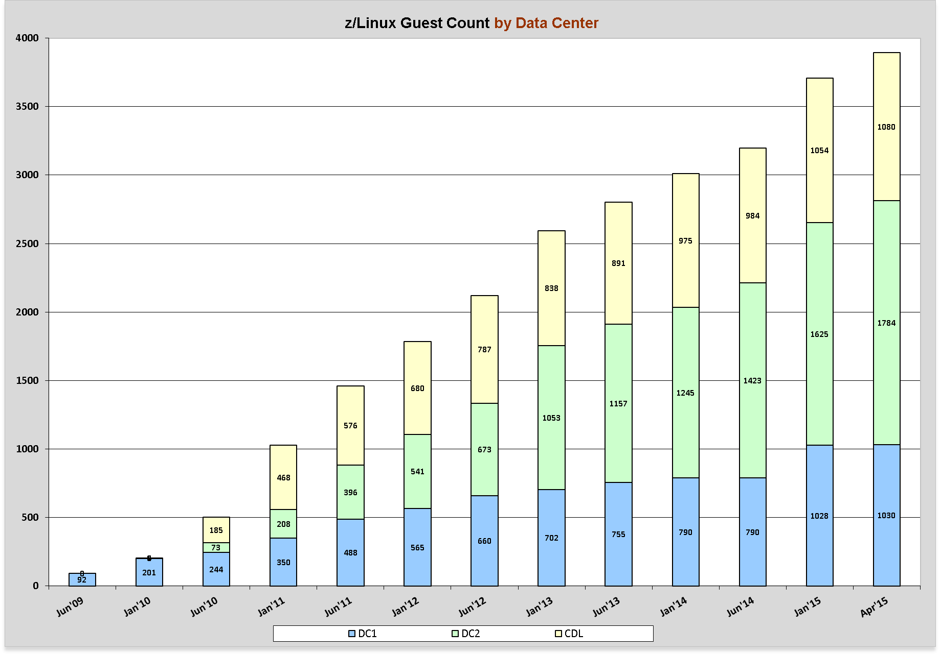
Virtualization Project
This is true virtualization and not just consolidation
Average Virtual to Real Memory over-commit is 1.5:1 (Max – 3.0:1)
Average Virtual to Real CPU over-commit is 14:1 (Max – 44:1)
Mixed applications sharing same resources – WAS, Oracle, CSL, Cognos, Portal, etc.
Prod and Non-Prod LPAR’s sharing resources
Notes:
I need to add the next 2 years of this growth

Slide 8


