Slide 1
How z/VM Begins
Tim Greer
z/VM System Test
timgreer@us.ibm.com
Notes:
Last updated 2015-06-18 by Tim Greer
1

Slide 2
Trademarks
The following are trademarks of the International Business Machines Corporation in the United States, other countries, or both.
Not all common law marks used by IBM are listed on this page. Failure of a mark to appear does not mean that IBM does not use the mark nor does it mean that the product is not actively marketed or is not significant within its relevant market.
Those trademarks followed by ® are registered trademarks of IBM in the United States; all others are trademarks or common law marks of IBM in the United States.
For a complete list of IBM Trademarks, see www.ibm.com/legal/copytrade.shtml:
*, IBM Systems, IBM System z10®, IBM System Storage® , IBM System Storage DS®, IBM BladeCenter®, IBM System z®, IBM System p®, IBM System i®,
IBM System x®, IBM IntelliStation®, IBM Power Architecture®, IBM SureOne®, IBM Power Systems™, POWER®, POWER6®, POWER7®, POWER8®, Power ®, IBM z/OS®, IBM AIX®, IBM i, IBM z/VSE®, IBM z/VM ®, IBM i5/OS®, IBM zEnterprise®, Smarter Planet™ ,Storwize®, XIV® , PureSystems™, PureFlex™, PureApplication™ , IBM Flex System™ , Smarter Storage
The following are trademarks or registered trademarks of other companies.
Adobe, the Adobe logo, PostScript, and the PostScript logo are either registered trademarks or trademarks of Adobe Systems Incorporated in the United States, and/or other countries.
Cell Broadband Engine is a trademark of Sony Computer Entertainment, Inc. in the United States, other countries, or both and is used under license therefrom.
Java and all Java-based trademarks are trademarks of Sun Microsystems, Inc. in the United States, other countries, or both.
Microsoft, Windows, Windows NT, and the Windows logo are trademarks of Microsoft Corporation in the United States, other countries, or both.
Intel, Intel logo, Intel Inside, Intel Inside logo, Intel Centrino, Intel Centrino logo, Celeron, Intel Xeon, Intel SpeedStep, Itanium, and Pentium are trademarks or registered trademarks of Intel Corporation or its subsidiaries in the United States and other countries.
UNIX is a registered trademark of The Open Group in the United States and other countries.
Linux is a registered trademark of Linus Torvalds in the United States, other countries, or both.
ITIL is a registered trademark, and a registered community trademark of the Office of Government Commerce, and is registered in the U.S. Patent and Trademark Office.
IT Infrastructure Library is a registered trademark of the Central Computer and Telecommunications Agency, which is now part of the Office of Government Commerce.
* All other products may be trademarks or registered trademarks of their respective companies.
Notes:
Performance is in Internal Throughput Rate (ITR) ratio based on measurements and projections using standard IBM benchmarks in a controlled environment. The actual throughput that any user will experience will vary depending upon considerations such as the amount of multiprogramming in the user's job stream, the I/O configuration, the storage configuration, and the workload processed. Therefore, no assurance can be given that an individual user will achieve throughput improvements equivalent to the performance ratios stated here.
IBM hardware products are manufactured from new parts, or new and serviceable used parts. Regardless, our warranty terms apply.
All customer examples cited or described in this presentation are presented as illustrations of the manner in which some customers have used IBM products and the results they may have achieved. Actual environmental costs and performance characteristics will vary depending on individual customer configurations and conditions.
This publication was produced in the United States. IBM may not offer the products, services or features discussed in this document in other countries, and the information may be subject to change without notice. Consult your local IBM business contact for information on the product or services available in your area.
All statements regarding IBM's future direction and intent are subject to change or withdrawal without notice, and represent goals and objectives only.
Information about non-IBM products is obtained from the manufacturers of those products or their published announcements. IBM has not tested those products and cannot confirm the performance, compatibility, or any other claims related to non-IBM products. Questions on the capabilities of non-IBM products should be addressed to the suppliers of those products.
Prices subject to change without notice. Contact your IBM representative or Business Partner for the most current pricing in your geography.
Notes:
2

Slide 3
Disclaimer
The information contained in this document has not been submitted to any formal IBM test and is distributed on an "AS IS" basis without any warranty either express or implied. The use of this information or the implementation of any of these techniques is a customer responsibility and depends on the customer's ability to evaluate and integrate them into the operational environment. While each item may have been reviewed by IBM for accuracy in a specific situation, there is no guarantee that the same or similar results will be obtained elsewhere. Customers attempting to adapt these techniques to their own environments do so at their own risk.
In this document, any references made to an IBM licensed program are not intended to state or imply that only IBM's licensed program may be used; any functionally equivalent program may be used instead.
Any performance data contained in this document was determined in a controlled environment and, therefore, the results which may be obtained in other operating environments may vary significantly. Users of this document should verify the applicable data for their specific environments.
It is possible that this material may contain reference to, or information about, IBM products (machines and programs), programming, or services that are not announced in your country. Such references or information must not be construed to mean that IBM intends to announce such IBM products, programming or services in your country.

Slide 4

Agenda
How does z/VM know how to start?
  Where is SYSTEM CONFIG?
  Where is CPLOAD?
  What else could there be?
A walk through SYSTEM CONFIG
What starts automatically? And how?
  OPERATOR’s PROFILE EXEC
  AUTOLOG1
What might you want to change?
  USER DIRECTory
  SYSTEM CONFIG
  PROFILE EXECs
  IPLPARMS
Notes:
Not to scale! We will start with the HMC load panel, spend a little time on the SAPL screen, then spend a lot of time with SYSTEM CONFIG. PROFILE EXEC content is left as reading exercise, but we will point out how OPERATOR and AUTOLOG1 are chosen. Finish up by acknowledging USER DIRECT and mentioning some users that need configuration.

Slide 5
How does z/VM know where to start?
How far back to go…?
Hardware Management Console
SAPL screen
  SYSTEM CONFIG
  CPLOAD MODULE
Notes:
Should we start with mining the minerals to build a z13? No, that’s too far back. We’ll start with the LOAD panel from the HMC. (Implies your LPAR is already defined with storage size, processors, etc., and you know how to select it on the HMC.) The LOAD panel specifies the DASD on which the Stand Alone Program Loader (SAPL) is. SAPL specifies the name and location of the system configuration file (default: SYSTEM CONFIG) as well as the name and location of the program that is CP (default: CPLOAD MODULE). SAPL can also specify other stuff, such as where the system operator is to be logged on.

Slide 6
Finding the first pieces
HMC Panel
SAPL screen
SAPL
DRCT (object directory)
PARM disk (SYSTEM CONFIG)
Minidisk where CPLOAD is
Notes:
A visual summary of what we are about to walk through.

Slide 7
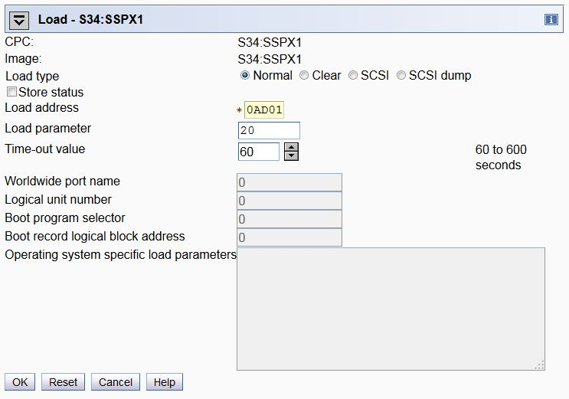
HMC Load panel
Notes:
This is typical appearance of the load panel on the Hardware Management Console (HMC). The parameter values originally came from customizing the Activation Profile of the LPAR, but they’re saved from whatever was used most recently.

Slide 8
HMC Load panel
Notes:
Look here!

Slide 9
HMC Load panel
The “RES” pack has SAPL.
SAPL will appear on the console you specify.
Notes:
“Load address” is the DASD pack you will “IPL”. The program that will be loaded is SAPL, the Stand Alone Program Loader.
“Load parameter” is the console address. This needs to be in SYSTEM CONFIG. Besides numbers, it could be SYSG.
Load type is usually “Normal”. “Clear” makes sure memory is zeroed – might be useful for security or if you expect to soon be taking a Stand-Alone Dump.
A failing load will time out, but not in the 60 seconds this seems to imply.

Slide 10
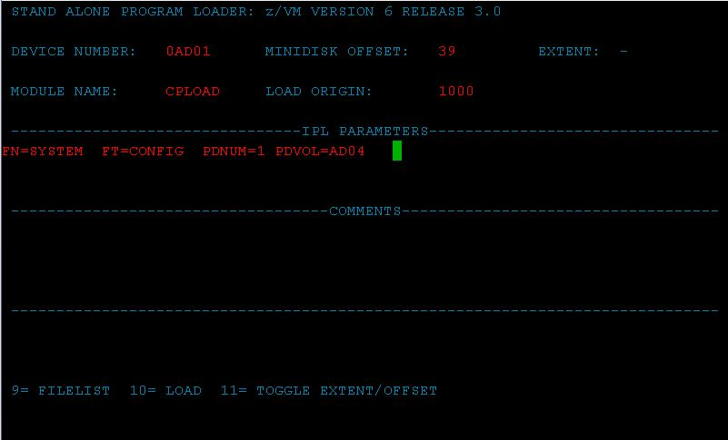
Stand-Alone Program Loader (SAPL) screen
Notes:
When your LOAD completes (may take only a few seconds, could be minutes) you see the screen of the Stand Alone Program Loader. The SALIPL utility was used by Install to fill in the details.

Slide 11
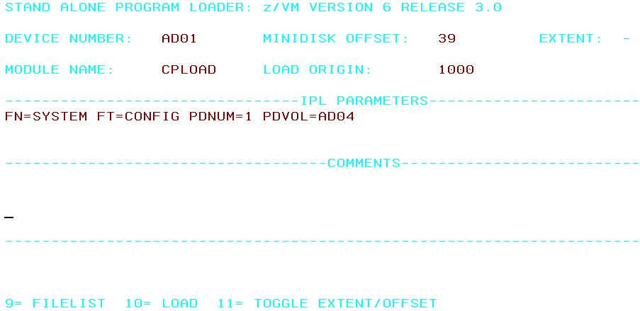
Stand-Alone Program Loader (SAPL) screen
Notes:
The previous screen was what the SAPL screen really looks like. But we are switching to a white background to improve legibility.

Slide 12
Stand-Alone Program Loader (SAPL) screen
These determine SYSTEM CONFIG
Notes:
PDNUM is “PARM disk number”. PDVOL is “PARM disk volume”. So we are pointing to the PDNUMth PARM disk on DASD pack PDVOL (in this case, the 1st on AD04), and then specified filename/filetype of SYSTEM CONFIG. Notice that the PDVOL is *not* the same as the load address in this case.

Slide 13
Stand-Alone Program Loader (SAPL) screen
Specifying the CPLOAD MODULE
Notes:
Use the file CPLOAD MODULE on the minidisk that starts at cylinder 39 on DASD AD01. The device number was filled in for you by virtue of choosing it on the HMC Load Screen. As an alternative to accepting CPLOAD or knowing the name of another CP version, you can mash PF09 to see a FILELIST of all the files on the indicated minidisk, and choose from among the MODULEs you see there.
The device number specified here is known as the System Residence volume (SYSRES is defined as “where CPLOAD is”). CP will look for DRCT space first on SYSRES, so we are in effect telling where to find the system directory (object directory) as well.

Slide 14
Fun facts
The minidisk with CPLOAD MODULE does not need to be allocated PARM.
…Unless you want to find it by “Extent” rather than “Offset”.
Notes:
See next slide for highlighting of extent vs. offset.

Slide 15
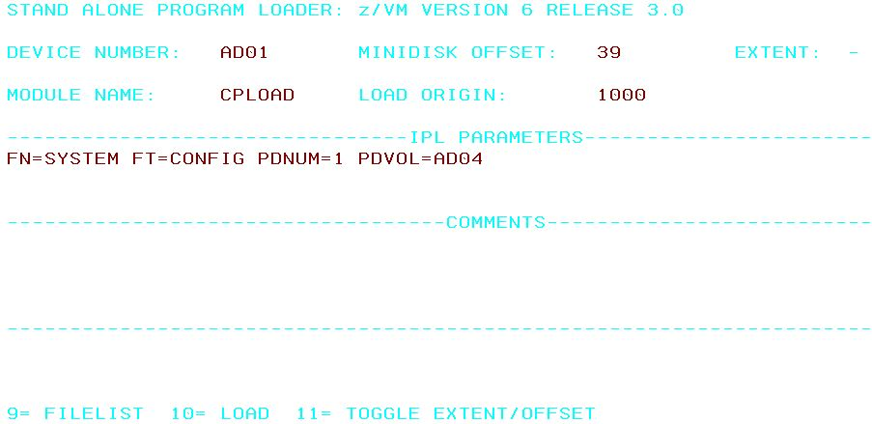
SAPL screen – EXTENT vs. OFFSET
Notes:
You can toggle between using “OFFSET” and “EXTENT” by using PF11. But “EXTENT” refers to the minidisks that have been allocated as PARM using CPFMTXA. If the minidisk you want to point to wasn’t so allocated (i.e. it is PERM), then you must use OFFSET.

Slide 16
Fun facts (continued)
The minidisk with CPLOAD MODULE does not need to be allocated PARM.
…Unless you want to find it by “Extent” rather than “Offset”.
You can pick any MODULE to load
  It doesn’t need to be named CPLOAD
  It doesn’t have to be CP, either!
    Examples: DDR, ICKSADSF
…Which means, we haven’t even started VM yet.
Notes:
SAPL can be used to start any stand-alone program. It does not have to be an operating system, although if you try to write such a program you quickly learn to appreciate what an operating system provides.
Since here we could choose any program on the minidisk, we actually have not started VM yet.

Slide 17
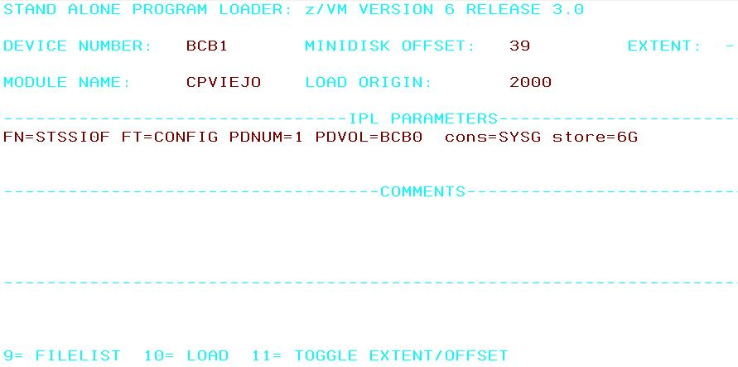
What else might go on the SAPL screen?
Notes:
Here we have changed a number of things. Note first that we have specified the console where OPERATOR will be connected (cons=SYSG). We have also specified that the system is to IPL with 6G of storage.
Other changes: Module name, filename of the system configuration file, PDVOL, Device Number, Load Origin.
Incidentally, Load Origin of 2000 is what CP actually uses (or rather, switches to) nowadays, even if you specify something different.

Slide 18
A walk through SYSTEM CONFIG
Who am I?
Where is all my stuff?
What am I allowing?
When do I adjust the time?
Why…?
How to specify various things?
Notes:
The “Who? What? When? …” journalism mantra illustrates the importance of SYSTEM CONFIG in providing answers to key questions. (The mantra alliteration works better in German.)

Slide 19
Who am I?
System_Identifier statement
  System_Identifier * * SLUG1
  System_Identifier 2097 031757 GUERNSEY Gateway Cow
  System_Identifier * * &LPARNAME
  System_Identifier_Default BEAR
SSI statement (if in an SSI)
  SSI SLUG PDR_VOLUME VMCOM1,
  SLOT 1 SLUG1
  /* SLOT 2 @@MEMSLOT2, */
  /* SLOT 3 @@MEMSLOT3, */
  /* SLOT 4 @@MEMSLOT4 */
Notes:
Several example System_Identifier forms are shown. The first is from an actual single-member SSI install. That form would not work if there were multiple members all using the same SYSTEM CONFIG. When you have multiple System_Identifier statements, CP reads from the top down, using the last one that applies. (So, &LPARNAME in this case. System_Identifier_Default is used only if none apply.)
The SSI statement is also from the single-member SSI install. This statement tells CP where the PDR is, and which members get which slot.

Slide 20
Where is all my stuff?
DASD Statements
  SLUG1: CP_Owned Slot 1 M01RES
  CP_Owned Slot 5 VMCOM1
  …
  SLUG1: BEGIN
  User_Volume_List M01W01 M01W02 M01W03
  SLUG1: END
System data from last run
  SLUG1: System_Residence,
  Checkpoint Volid M01RES From CYL 21 For 9 ,
  Warmstart Volid M01RES From CYL 30 For 9
Notes:
After figuring out who we are, we next need to find out where everything is. Notice the system name being used to specify the specific system these statement(s) apply to. Minidisks are on both CP_Owned and User_Volume DASD, but PAGE, SPOL, TDSK, DRCT and Checkpoint/Warmstart all must be on CP_Owned.
The System_Residence volume is also where CP will first check for a DRCT area.

Slide 21
What am I allowing? (part 1)
Priv_Classes ,
Operator A ,
IOCP_Read CE ,
IOCP_Write C ,
HW_Service F ,
User_Default G
System_Userids ,
Operator OPERATOR ,
Account DISKACNT ,
Dump OPERATNS ,
Erep EREP
Notes:
Both privilege classes and system UserID names are pretty standard. It’s probably a bad (confusing) idea to mess with them. If you want to change the privilege class of specific commands, use the MODIFY statement, e.g. “Modify Command SHUTDOWN PRIVCLASS Z”.

Slide 22
What am I allowing? (part 2)
Operator_Consoles ,
0020 0021 0022 0023 0E20 03E0 0E21 1020 ,
System_3270 System_Console
Emergency_Message_Consoles ,
0020 0021 0022 0023 0E20 03E0 0E21 1020 ,
System_Console
Notes:
“System_3270” = SYSG, “System_Console” = SYSC. What is the difference between an Emergency Message Console and the Operator Console? Emergency messages can’t go to SYSG. SYSC always exists – it’s the “Operating System Messages” icon on the HMC -- so there is always somewhere for emergency messages to go. SYSC is line mode, so you can’t use the SAPL screen there, but it can be the Operator Console if SYSTEM CONFIG is configured to allow automatic IPL. There is only one Operator Console, but emergency messages go to all the specified consoles that exist.
The system operator (user OPERATOR by default) gets logged on to one of the Operator_Consoles when the system comes up. For this reason, all the specified consoles should be in a physically secure location. Likewise for security, if you specify (on the SAPL screen) an operator console that is not currently available (e.g. “cons=SYSG” and you forgot to start the 3270 integrated console session), the system will not IPL. Instead, you will get an HCP1010W wait state.

Slide 23
What am I allowing? (part 3)
Features ,
Disable ,
Set_Privclass ,
Auto_Warm_IPL ,
Clear_TDisk ,
Retrieve ,
Default 20 ,
Maximum 255 ,
MaxUsers noLimit ,
Passwords_on_Cmds ,
Autolog yes ,
Link yes ,
Logon yes ,
Vdisk Userlim 144000 blocks
Notes:
A few features are set up by Install, including some you may want to change, such as allowing passwords on commands. But FEATURES makes available options not listed here, e.g. Set_Privclass, other autostart/restart options.

Slide 24
When do I adjust the time?
Timezone_Definition EDT West 04.00.00
Timezone_Definition EST West 05.00.00
Timezone_Definition CDT West 05.00.00
…
Timezone_boundary on 2015-03-08 at 02:00:00 to EDT
Timezone_boundary on 2015-11-01 at 02:00:00 to EST
Timezone_boundary on 2016-03-13 at 02:00:00 to EDT
Timezone_boundary on 2016-11-06 at 02:00:00 to EST
Notes:
Self-explanatory, but fun to be able to specify Newfoundland time, NFD West 02.30.00

Slide 25
Why…?
“No, no! There is no ‘why’.”
-- Yoda

Slide 26
How to specify various things? (part 1)
Language:
  User_Defaults CPLANG UCENG
Powers of Special Characters:
  Character_Defaults ,
  Char_Delete OFF ,
  Escape '"' ,
  Line_Delete OFF ,
  Line_End '#' ,
  Tab OFF
Notes:
There are not many choices for language nowadays. Show of hands: Who wants their system to use UCENG?
Character defaults can also be specified in hex, e.g. “Line_End x'7B‘ ”.

Slide 27
How to specify various things? (part 2)
Choose the logo screen:
  CP_Access MAINT CF1 A
  CP_Access MAINT CF3 C
  …
  Logo_Config LOGO CONFIG
Notes:
You can create various logos and put them in multiple files. For CP to see them, the files have to be on a minidisk that CP has accessed. It is possible for the system to be using multiple logos, e.g. one for direct connects, another for everything else.

Slide 28
How to specify various things? (part 3)
Devices ,
Online_at_IPL 0000-FFFF,
Sensed 0000-FFFF
Form_Default …
PRODUCT PRODID 6VMRSC30 STATE DISABLED …
…
(Note that these are generally licensed products.)
Notes:
Since we pick up DASD by label, it can be useful to make some DASD offline_at_IPL in order to avoid unintentionally picking up DASD with the same labels as that intended for this system. You definitely need to be aware of this possibility if you do multiple installs, use default values for labels, and allow your LPARs access to each other’s DASD.
Notice that here we show RSCS DISABLED. If you tried to bring up RSCS, it would die with a message amounting to “You forgot to SET PRODUCT PRODID 6VMRSC30 STATE ENABLED.”

Slide 29
How to specify various things? (part 4)
Where is the directory really?
Source directory USER DIRECT starts out on PMAINT.2CC
CPFMTXA shows allocation map of SYSRES disk:
PERM 0 0 1
DRCT 1 20 20 ← Object directory
PERM 21 38 18
PARM 39 158 120
PARM 159 159 1
PARM 160 279 120
PERM 280 3338 3059
Notes:
Use DIRECTXA to write USER DIRECT out to the DRCT area. That is, to write the source directory to the object directory. CP looks for the DRCT area first on the system residence (SYSRES) disk, the IPL disk, then on CPOWNed volumes in slot order. (You might notice also that there is a PARM disk starting at cylinder 39. Recall that is where the SAPL screen told the system to find the CPLOAD it was IPLing. Also notice the 18 cyl of PERM starting at 21 – that’s the checkpoint and warmstart areas.)
While the source directory starts out on PMAINT.2CC, it doesn’t necessarily stay there. If you use DIRMAINT, it has its own place(s) to keep it.
Some esoteric information: While install puts SAPL, DRCT, checkpoint/warmstart areas, and the minidisk with CPLOAD all on the same volume, it is possible to spread this stuff around. The DASD with SAPL is known as the IPL volume; the DASD with CPLOAD is SYSRES, the System Residence volume. By changing the Device Number on the SAPL screen, you can point to a SYSRES other than the IPL volume. SYSTEM CONFIG has a System_Residence line defining where the checkpoint and warmstart areas are, and CP will use the first DRCT area on that volume if a DRCT area exists there. Otherwise it looks on CPOWNed volumes in slot order.

Slide 30
Fun Facts
SYSTEM CONFIG has many other statements available
FEATURES statement has many powers
Multiple FEATURES statements are allowed, and are useful
Many SYSTEM CONFIG statements have corresponding SET commands
CPSYNTAX exists to check SYSTEM CONFIG changes before you re-IPL
Notes:
A reason to use multiple FEATURES statements, rather than a single one consisting of many lines joined with commas, is protection against mistakes. Unless you specify otherwise, CP handles errors in SYSTEM CONFIG by simply ignoring the statement on which the error occurs. So if you make a typo on your short FEATURES statement, all the other FEATURES statements will still be valid, but if the typo was on your one huge statement, CP will ignore it all.

Slide 31
What starts automatically? And how?
OPERATOR runs PROFILE EXEC
…and everything follows from there.
Or…
AUTOLOG1 runs PROFILE EXEC
  …and everything follows from there
Or…
AUTOLOG1 starts RACF, then starts AUTOLOG2…
Or…
Go look at SYSTEM CONFIG for hints
Notes:
On a new install, OPERATOR’s PROFILE EXEC does nothing (and OPERATOR does not even IPL CMS). But AUTOLOG1 starts several users. You can IPL the system with the NOAUTOlog option to make OPERATOR the only user that gets logged on.
It might be worth noting that on a system with an External Security Manager, e.g. RACF, the ESM needs to get started before everything else. So AUTOLOG1 will XAUTOLOG RACF. AUTOLOG2 exists to then take over the configured tasks; AUTOLOG2 is not set up to do anything – or even be logged on – on a non-ESM system.
Operations Manager is a product that, among other things, can help in control tasks such as “don’t start UserB until UserA is up and running.”

Slide 32
System UserIDs may be autologged
System_Userids ,
Operator OPERATOR noDisconnect ,
Account DISKACNT Autolog ,
Startup AUTOLOG1 Autolog ,
Dump OPERATNS ,
Erep EREP Autolog ,
Symptom OPERSYMP Autolog
(This SYSTEM CONFIG statement automatically logs on 5 users.)

Slide 33
Actually, System UserIDs *will* be autologged
System_Userids ,
Operator OPERATOR noDisconnect ,
Account DISKACNT ,
Startup AUTOLOG1 Autolog ,
Dump OPERATNS ,
Erep EREP ,
Symptom OPERSYMP
(This SYSTEM CONFIG statement automatically logs on the same 5 users.)
Notes:
The “Startup” user AUTOLOG1 is not a “System UserID”, though, so it still needs the “Autolog” parameter.

Slide 34
System UserID surprises
System_Userids ,
Operator OPERATOR noDisconnect ,
Dump OPERATNS
(This SYSTEM CONFIG statement results in the following startup messages.)
XAUTOLOG OPEREREP
HCPAUT053E OPEREREP not in CP directory
XAUTOLOG OPERACCT
HCPAUT053E OPERACCT not in CP directory
XAUTOLOG OPERSYMP
Command accepted
(CP defaulted to OPERxxxx names; of these, only OPERSYMP happens to be defined in the standard
install.)
Notes:
If SYSTEM CONFIG fails to specify UserIDs for EREP, ACCT, and SYMP, CP defaults to these OPERxxxx UserIDs. Unfortunately, of these, the standard install defines only OPERSYMP. Recall that install used EREP and DISKACNT for the other two.

Slide 35
What might you want to change?
SYSTEM CONFIG statements
USER DIRECTory
PROFILE EXECs
  OPERATOR
  AUTOLOG1/AUTOLOG2
Configuration files
  TCPIP: DTCPARMS, PROFILE TCPIP, etc.
  RSCS: PROFILE GCS, PROFILE RSCS, RSCS CONFIG
SET IPLPARMS and/or SALIPL
Notes:
Of course we could go on and on here. Other examples of products needing configuration include PerfKit, DIRMAINT, and RACF.

Slide 36
Some hints to figure out what is going on
Look in SYSTEM CONFIG
Look at PROFILE EXEC of OPERATOR, AUTOLOG1
Look at spooled console of OPERATOR
  See who gets autologged by whom
  See whether users stay logged on (If they fail IPL, this suggests they have not been set up)
  Check for complaints about errors in SYSTEM CONFIG
Look at USER DIRECT
  Entries can have CMD statements
QUERY IPLPARMS, QUERY CPLOAD, QUERY CPLEVEL
Notes:
It’s easy to get used to ignoring the startup messages, but sometimes excellent clues – or even straight answers – are there.
The possibility of COMMAND/CMD statements in USER DIRECT was an afterthought. Install does not put them there, but a SYSADMIN before you came along might have.
Q IPLPARMS shows what was used on the SAPL screen (or was set by the last SET IPLPARMS).
Q CPLOAD gives PDVOL label and PD offset (sort of the same information as PDNUM/PDVOL that you might see from Q IPLPARMS, but isn’t affected by an intervening SET IPLPARMS).
Also note that IPLPARMS can be set as part of a SHUTDOWN REIPL command.

Slide 37
A special slide for users of 2nd level systems
Getting to the SAPL screen:
TERM CONMODE 3270
DEF 9 AS 20 (if needed)
IPL AD01 CLEAR LOADPARM 20
Skipping the SAPL screen:
(Use SALIPL to set up parameters as needed)
TERM CONMODE 3270
DEF 9 AS 20 (if needed)
IPL AD01 CLEAR
Note: In REXX, you can put all 3 CP commands on one line, separated by x’15’.
‘TERM CONMODE 3270’ || x2c(15) || ‘DEF 9 20’ || x2c(15) || ‘IPL AD01 CLEAR’
Notes:
This is a slide for people who IPL VM 2nd-level, i.e. as a guest. Notice that the difference in whether you get the SAPL screen or not is the use of the LOADPARM on the IPL statement. Use CP Q CONS to find out if your console is at address 009 (or anything else) and needs to be changed to 20 (to match what is in SYSTEM CONFIG). If you want to do everything in a REXX EXEC, use SALIPL to specify the CPLOAD MODULE, IPLPARMS, etc. and then use the x’15’ trick to put all the statements that kill CMS onto one line, which will of course be the last line your EXEC executes.

Slide 38
A special slide for users of 2nd level systems
Getting to the SAPL screen:
TERM CONMODE 3270
DEF 9 AS 20 (if needed)
IPL AD01 CLEAR LOADPARM 20
Skipping the SAPL screen:
(Use SALIPL to set up parameters as needed)
TERM CONMODE 3270
DEF 9 AS 20 (if needed)
IPL AD01 CLEAR
Note: In REXX, you can put all 3 CP commands on one line, separated by x’15’.
‘TERM CONMODE 3270’ || x2c(15) || ‘DEF 9 20’ || x2c(15) || ‘IPL AD01 CLEAR’
Notes:
In case anyone missed the difference between getting the SAPL screen or skipping it, inclusion of the LOADPARM parameter controls this.

Slide 39
Summary
HMC Load panel specifies disk with SAPL, and a console.
SAPL screen points to
  System configuration file (SYSTEM CONFIG), by way of PARM Disk volume and PARM disk number (PDVOL, PDNUM)
  CPLOAD MODULE, by way of SYSRES volume and extent/offset
CP reads SYSTEM CONFIG to learn initialization parameters, establish features, choose DASD, etc.
CP finds object directory in DRCT space on SYSRES volume
System UserIDs specified in SYSTEM CONFIG are autologged
PROFILE EXECs in system UserIDs specify what happens next

Slide 40
For More Information …
Web sites:
  http://www.vm.ibm.com/ -- zVM on the Web
  http://www.vm.ibm.com/library -- the online zVM Library
  http://www.vm.ibm.com/education -- presentations, classes and information
Via mailing lists:
  IBMTCP-L@VM.MARIST.EDU
  IBMVM@LISTSERV.UARK.EDU
  LINUX-390@VM.MARIST.EDU
Contact Information:
Tim Greer
z/VM System Test
timgreer at us dot ibm dot com
+1 607.429.3598

Slide 41
Dank u
Dutch
Merci
French
Спаcибо
Russian
Gracias
Spanish
شكراً
Arabic
감사합니다
Korean
Tack så mycket
Swedish
धन्यवाद
Hindi
תודה רבה
Hebrew
Obrigado
Brazilian
Portuguese
谢谢
Chinese
Dankon
Esperanto
Thank You
ありがとうございます
Japanese
Tak
Danish
Trugarez
Breton
Danke
German
Grazie
Italian
நன்றி
Tamil
ขอบคุณ
Thai
děkuji
Czech
go raibh maith agat
Gaelic
Notes:
Isn’t it nice that they have translated all those foreign words and phrases on this slide for you? I had no idea “Merci” meant “French”.

Slide 42
Glossary – brief explanation of some terminology
CPFMTXA - Utility for formatting and specifying usage of (“allocating”) DASD.
CPLOAD MODULE - Default name of the Control Program for VM (in a sense, this is VM).
DASD - Direct Access Storage Device.
DIRECTXA - Utility for compiling the source directory and writing it as the object directory.
DRCT - Region on SYSRES volume allocated for the object directory.
HMC - Hardware Management Console.
IPL - Initial Program Load. As a verb, this means to start whatever program is on a device.
PARM disk - Region allocated for special minidisks intended for SYSTEM CONFIG, etc.
SALIPL - Utility used to write SAPL to cylinder 0 (or blocks 5 to 207) of DASD.
SAPL - Stand Alone Program Loader. Used to initialize and start other programs.
SYSRES volume - DASD specified on SAPL screen where DRCT and CPLOAD are.
System Configuration File - File containing configuration data; usually SYSTEM CONFIG.
System Console - Screen where system operator (OPERATOR) gets logged on.
System Directory - Definitions of all users on the system. Compiled form is in DRCT area.

