Slide 1


Changing the way we view legacy applications
Joe Zozzaro
Director Mainframe Division
Joe.Zozzaro@cmfirstgroup.com

Slide 2
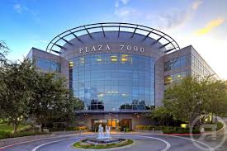
About The Company
HQ: Austin, Texas USA
  2 Offices in Europe
Work with over 400 IBM i/z Software Development Organizations
Partner with IBM, CA Technologies, and others
Nearshore and Offshore teams

Slide 3









Why Customers Choose Us for Modernization
Superior Automated Analysis
and Transformation Tooling
Experience with both “AS IS”
and “TO BE” environments
Focus on
Business Rules
Track Record for
Modernization Projects
Package
Implementation Support
Code
Transformation
BPM / BRE / Microservices
Layers Enable Phased
Approach and Fast Adoption
Project Architecture and Management

Slide 4

What Is Meant
By Legacy?
A software program that is outdated or obsolete. It may be unstable because of compatibility issues with current operating systems, browsers and information technology (IT) infrastructures.
The app was written some time ago, its original authors moved on taking knowledge with them (lost knowledge). Subsequent authors changed the application based on insufficient / lost knowledge, introducing bugs and de-stabilizing it.
An old method, technology, computer system, or application program, "of, relating to, or being a previous or outdated computer system."

Slide 5
What Is Meant
By Legacy?
Can imply that the system is out of date or in need of replacement.
The application is now fragile, and people are reluctant to change it for fear of breaking it.
Associated with or implies a product, programming language, or Operating System.

Slide 6
What Is Meant
By Legacy?
Means that it paved the way for the standards that would follow it.
Critical to the day-to-day operations of the company.
An application in which a company or organization has invested considerable time and money.

Slide 7

Issues/ChallengeS/Pain Points
Current employees assigned to the Legacy systems may not have the depth of skills or experience necessary to make the necessary changes.
Available company documentation about the legacy applications may be inadequate and not up to date. In some cases, there might not be any documentation at all.
Finding and attracting adequate resource/skills to enhance Legacy applications has become difficult.
Many different application systems were probably developed by different sets of teams. There could be inconsistency between programming styles and approaches.

Slide 8
Issues/Challenges/Pain Points
Over time, enhancements and maintenance performed on the Legacy applications may have changed the structure of the applications, the components, or even the business rules.
In house resources may have been redeployed to support newer technologies.
Higher percentages of the IT budget go toward managing and enhancing existing Legacy systems.
Applications might not run/be supported on the most current hardware or software platform.
Interest in moving to another platform.

Slide 9

CM evolveIT
A product suite that contains a complete set of tools for analyzing and documenting Legacy applications. CM evolveIT models every aspect of an application from the screens that users see down to the manipulation of individual data items deep inside the programs.
Interactive user interface: all queries, reports, diagrams, and code listings are completely interactive allowing the user to drill up or down in any direction to gather the next piece of information point-to-point.
Understand legacy system component and data dependencies to logically segment the application portfolio into manageable pieces to ensure no disruption to the rest of the application portfolio when decommissioning portions of the legacy system. .

Slide 10
CM evolveIT
Users can share analysis results: diagrams, queries, reports, and notes to ensure that even junior team members can be experts on existing applications.
Guides analysts through finding, interpreting, describing and modeling the abstracted business rules so that they can be used in any environment.
Complexity and other assessment metric reports allow managers to understand areas of risk, and plan modernization options accordingly.

Slide 11






Save Time
and Money
Ramp new resources
and leverage SME’s
  Improve
  System Insight
Reduce
Risk
Analysis done in minutes, not days
Pre-Discovered central repository with all information at analyst finger tips
Instant documentation
always up-to-date
Configurable reports & diagrams that can be saved, exported and shared
Capture Business Rules as implemented in the code
System-wide impact analysis through every data move, offset and redefine
    Avoid surprises with 100%
    accuracy based on the code
    Map system partitions
    and isolate complexity

Slide 12

Automated Analysis Time Advantage
CM evolveIT

Slide 13






CM evolveIT Architecture
Mainframe Libraries
CM evolveIT Windows Server
COBOL Pgms, Copybooks
JCL Jobs, Procs, Control Cards,
CICS , BMS maps, transactions
Database, VSAM, DB2, DCL Gens, SQL DDL/SP, IMS
ftp
Staging
Directories
Discovery
Workbench
MetaData Repository
Analysis
Clients
Job schedule
Other languages
Text documents
CM evolveIT install complete:
No additional software required

Slide 14


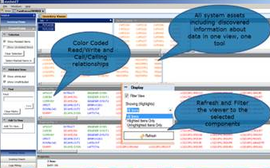
evolveIT
Architecture
A Single Dashboard View of All System Components

Slide 15
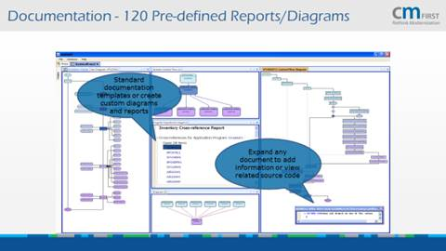
evolveIT
Architecture
Documentation 120 Pre-defined Reports/Diagrams

Slide 16





Traditional Rules Harvesting Approach
Read the program code to find the decisions
Get a definition of how the programs work rather than business rules
Create a definition of how to rebuild the current system
Extremely
error-prone

Slide 17
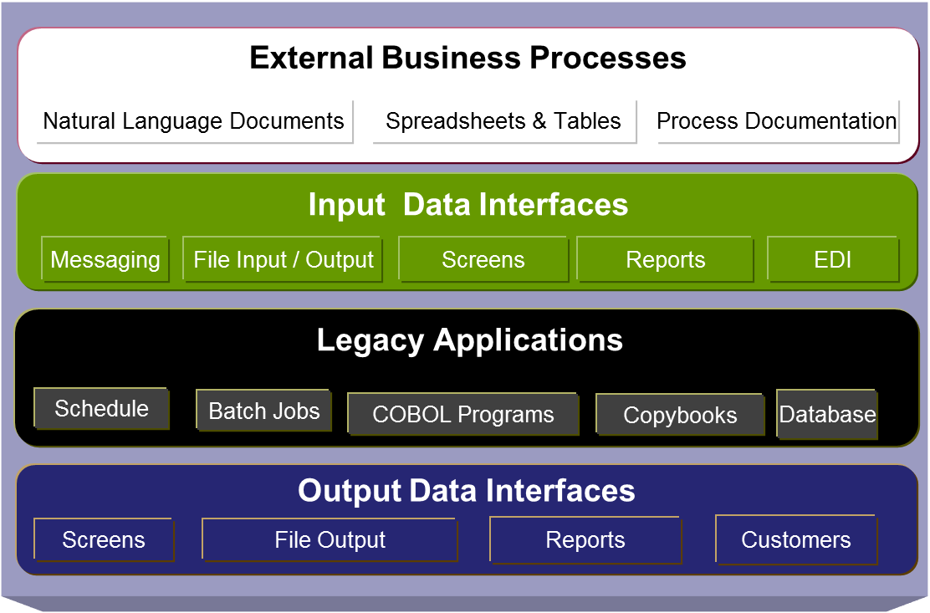

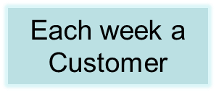
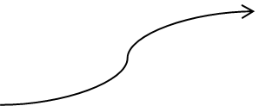
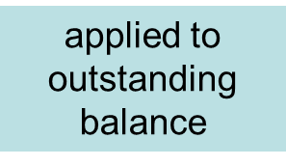
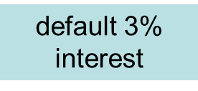

Collating
Rules is
difficult

Slide 18
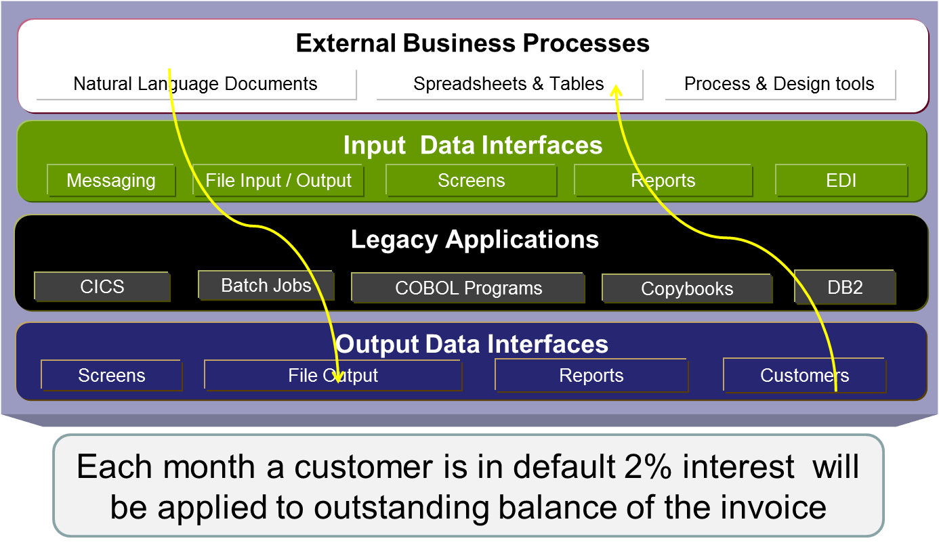
Extract rules through the stack

Slide 19

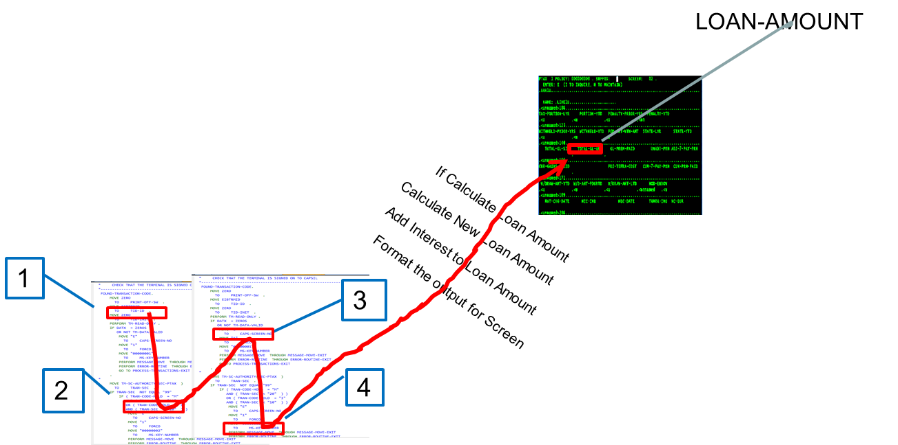
Logic Slicing / Filtering
CM evolveIT Data Trace finds the source that impacts the business rules.
Filters out the source that that is unrelated.
Takes minutes instead of days to understand how a field is created

Slide 20







Rules Approach
A business-centered approach to understanding the Business Rules in your Mainframe Application:
  Model the Application using evolveIT Automated Capture
  Identify Application Related Business Process
  Identify data in and out of the Application for each Business Process.
  Define the Business Terminology for Input / Output Data
  Complete Data Logic Trace within Application
  Combine to build Business Rules

Slide 21

Rules Approach
Source Code Analysis
Business Analysis
Business Process Review
Align
Business
Terminology
External
Business
Rules
Business
Rule
Definition
Parse
Technology
Application Analysis
System
Interface
Analysis
Data
Mapping
Data
Processing
Capture

Slide 22

Discussion
cmevolveit.cmfirstgroup.com

