Slide 1
Mainframe brain drain?
The Millennials, the Myths and z
Christy Schroeder
WW z Systems Client Skills Offering Manager
christys@us.ibm.com

Slide 2

Myth
Finding young folks with z skills is like finding a needle in a haystack

Slide 3
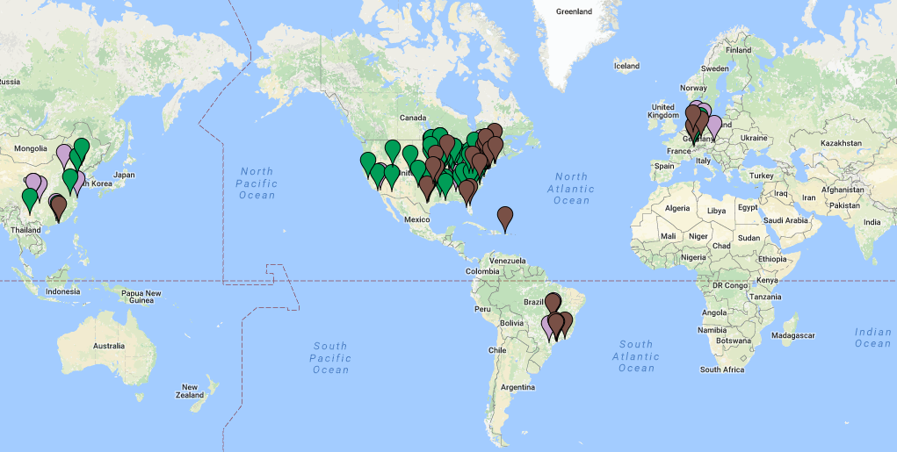
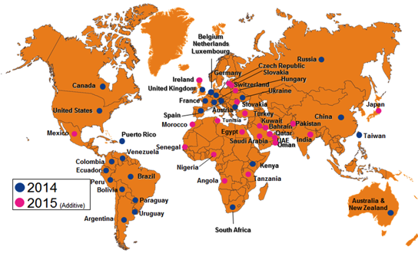
Fact
z Skills are being taught and acquired all around the world!
12 years
64 countries
z Academic Initiative Schools
  Google Maps
  AI website
Master the Mainframe
10,000 participants in 2016!!
    2015 Contest
    2016 Contest
2

Slide 4
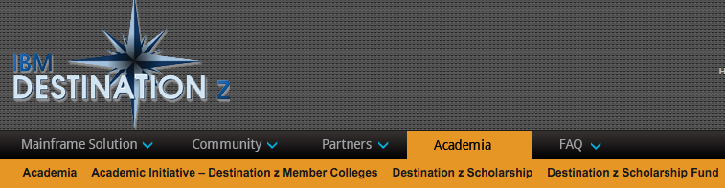
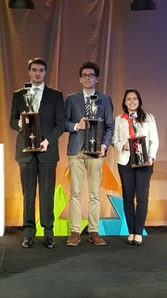
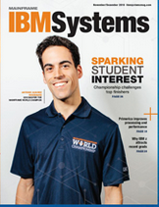
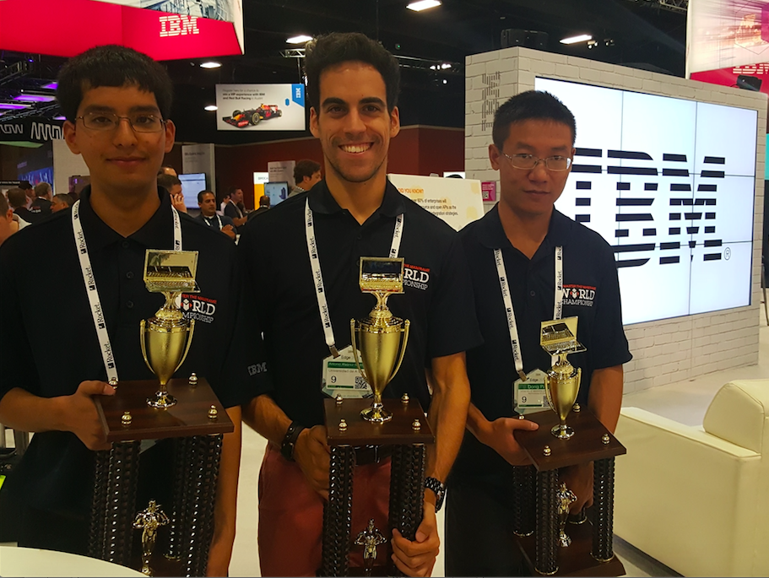
Fact
... and students are using our MtM Contest to jumpstart their careers in enterprise computing
Master the Mainframe winners use contest to jumpstart their careeers
Learning innovative, new technology
Wall of Fame

Slide 5

Myth
Finding millennials to work on z is as rare as a sighting of the Loch Ness monster

Slide 6
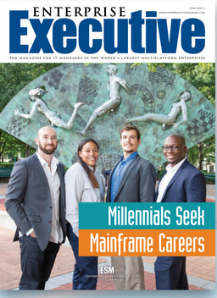
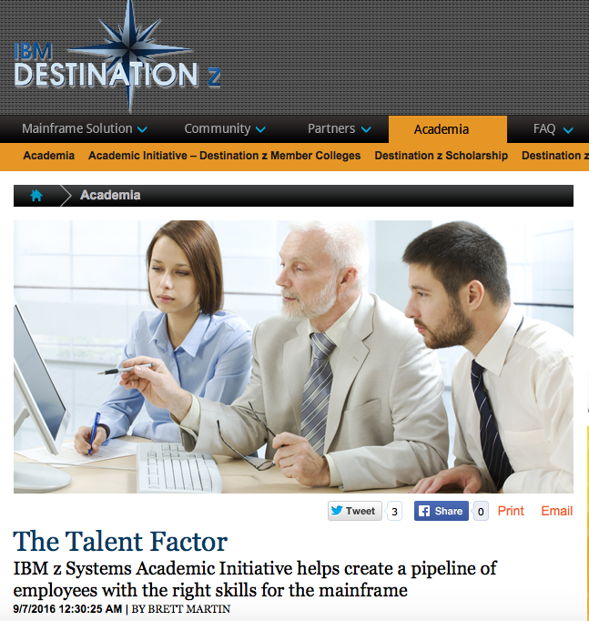
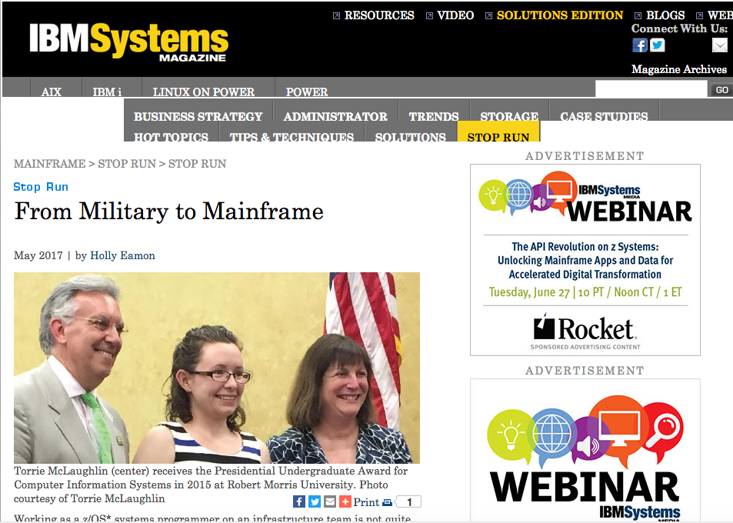
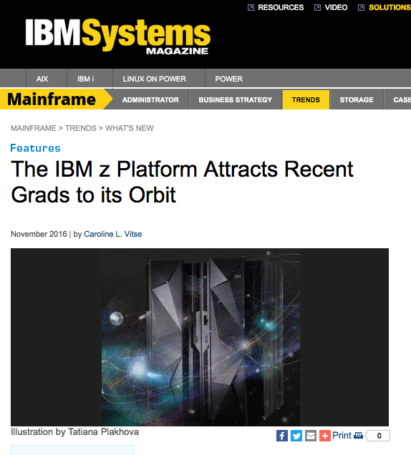
Fact
…Millennials are seeking careers in mainframe computing…
Millennials Mainframe Careers article
Pipeline of talent
Attracting recent grads article
From Military to Mainframe
5

Slide 7



Fact
…and are providing insight on how to attract more millennials to the z platform
Kyle Beausoleil, Rocket
  How to Reach Millennial Programmers
  How to Communicate with Millennials about the Mainframe
  How to Hire Young Mainframers
  Generation z Mainframers – Not the Unicorns We Think They Are
Holden O’Neal, SAS
  Bringing new blood to the mainframe: A millennial’s perspective
Abinash Satapathy, Student
  A College Student’s Passion for Learning z/OS!
Mainframe Co-op Experience at Manulife
  YouTube Video and LinkedIn Story
6

Slide 8
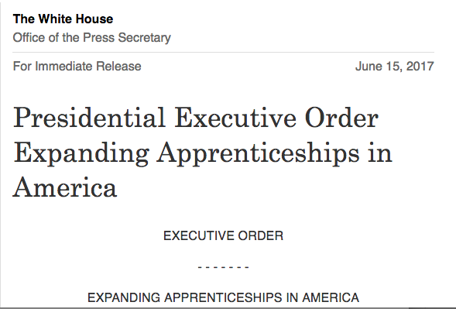
Fact
Developing programs in support of Presidential Executive Orders
$7.5 M Grant
Department of Labor Granted Contract to North Carolina A&T University to create a Mainframe Apprenticeship Program
  IBM
  SHARE
  MentorServices
7

Slide 9
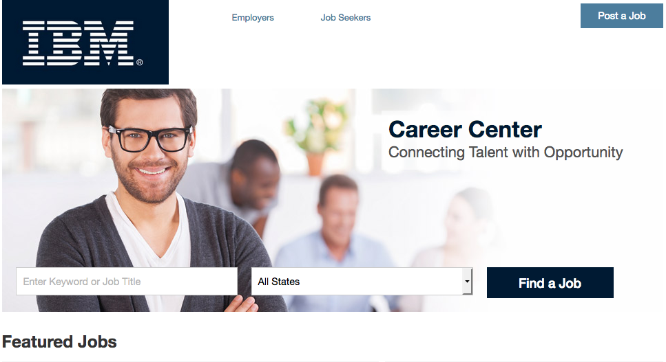

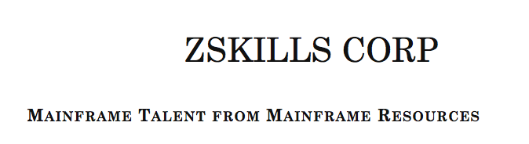

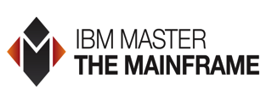
Fact
Help is available to assist in finding these millennials
IBM Career Center
Wall of fame
8

Slide 10
Insight
Start building relationships early!
Guest Lecture
Attend Career Fairs
Teach
Hire Interns
Sponsor an Event
Hire FT Employees
9

Slide 11

Myth
Mainframe training is like a luxury sports car, you want it, you just can’t afford it!

Slide 12
Fact
IBM offers terrific no-cost training options for z/VM…
Introduction to Virtualization: z/VM Basic Concepts and Terms
MP3 with PDF (3 hrs)
Master the Mainframe Learning Management System
Use as an assessment tool and get reports and earn badges!
z/VM Education Website
Live Virtual Classes
z/VM, KVM, Linux on z, VSE
IBM zSystems Course Materials for the Community
Includes an Intro to z/VM Course and Linux on z
Introduction to the New Mainframe: z/VM Basics
Redbook
11

Slide 13
Fact
as well as for z/OS and our subsystems…
z/OS Introduction and Workshop
October 9 - 13
IMS Customer Internship Program
Yearly
z/OS Customer Internship
October 23 - 27
Redbooks CICS Video Course
Developing a RESTful Web application with Liberty for CICS
Mainframe MOOC
June 5 – July 17
12

Slide 14
Fact
…including classes, e-learning courses, videos, webinars and more!
IBM Systems Magazine z Webinars
IBM Z Systems Channel
Mainframe Playground
z/OS, 196 Exercises, 41 Assignments, Self-Study
z Systems eLearning for IBM Customers
z Fundamentals, Value & Differentiation, Linux, Security, Cloud, Analytics, Mobile
What are Mainframes?
Assembler Language Programming for z Servers
1,200 page book by John Ehrman
13

Slide 15

Fact
We even offer a free LinuxONE Development environment...
Try it today!
  120 days
  2 virtual CPUs
  4 GB Memory
  40 GB Storage
ibm.com/linuxone/try
14
Notes:
Linux is Linux and LinuxONE is no different.
It gives all the benefits of the tools you already know and love (KVM, SUSE, DOCKER, MONGO, JAVA) along with the qualities only LinuxONE brings to the open world (performance, speed and security).
And to prove it, for everyone here today: you can log in to the new IBM LinuxONE Community Cloud and take it for a test drive yourself in just minutes.
For many years, we have been asked by developers and by students, “How can I get access to these systems? How can I test applications? How can I use sandboxes? How can I develop proof of concepts?” Clients have come to us and asked similar questions. So now, we offer the IBM LinuxONE Community Cloud. We are providing open access to LinuxONE virtual machines where you can do exactly that. Come into the systems, get a sandbox, build a proof of concept, try out new tools, try out new technologies, port, test, benchmark an application. Very, very
exciting new capability.
And if your skeptical or simply worried about trying something new…watch this and hopefully you will be inspired to take the next step.
It really is simple… access in minutes or just a few clicks. (6 min for first time registration, drops to 3 min from then on once we know who you are).

Slide 16
Fact
…and host z Council meetings, and support z user groups that are chocked full of terrific z content and provide helpful resources
VM User Groups
DB2 Regional User Groups
IBM z Council Meetings
RACF User Groups
Virtual CICS User Group
Virtual IMS User Group
15
Notes:
All things IMS: https://www.linkedin.com/groups/910927/910927-6235900424621297667

Slide 17
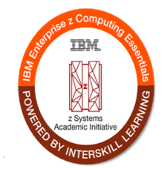

Fact
We even provide free training for students!
Introducing the new IBM z Enterprise Computing Kickstart Offering
  For students and faculty
  Over 40 hours of free e-learning
  Visit On The Hub
  Get your summer intern trained today!
Register Today
16

Slide 18
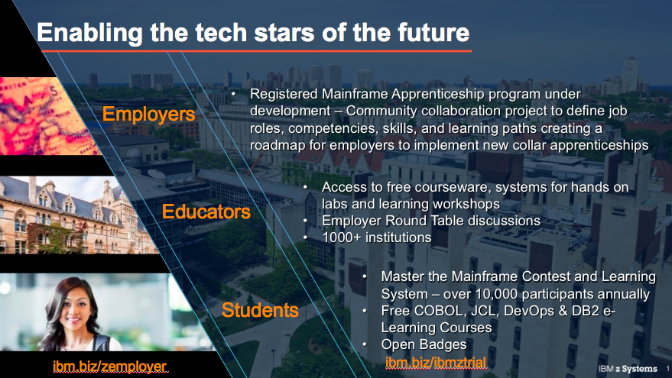
Fact
Providing resources, at every level, to ensure success
17
Notes:
Drive investment in skills and education through the academic initiative and broader skills programs to create diverse talent on-ramps
Creating skill building programs to help employers, educators and students.
We continue to drive our investment in education and skills through our Academic Initiative and skill programs. I’m very passionate about this program. At its essence, the IBM z Systems Academic Initiative is a global program that provides schools with the education resources they need to execute. It also provides student and employer direct programs to facilitate academic and professional student learning to build IT skills in high demand, and it expedites hiring connections in the marketplace by linking employers with talented, skilled students and professionals. The Academic Initiative has been a 14 year journey for IBM as we seek to inspire a growing pipeline of mainframe talent all over the world. Today we are enabling more schools and assisting more clients with hiring and skills building.
However, universities are only one component to ensuring we have the talent pipeline to drive new innovation and future growth. Therefore, we have doubled down on attracting new developers and talent to the mainframe throughout the complete learning lifecycle and creating on-ramps outside of 4 year degree programs. To facilitate this we are investing in programs for employers, educators and students - both inside and outside of academic institutions.
1. For Employers…We are creating a Pathway for new collar, skill based jobs by collaborating with the broader community to develop a Registered Mainframe Apprenticeship Program and recruit talent. Employers will be able to use this program as a boiler plate to implement apprenticeship programs in house. An apprenticeship is an earn and learn program combining structured and on the job learning over an 18-24 month period. The apprentice is hired at a reduced rate and then progresses through the program to become a certified mainframer in a specific job role. The program will be flexible and specific to each employer.
2. For Educators in universities, secondary and code schools, we provide access to the materials they need to teach these critical skills. We are helping to incorporate Enterprise Content into High School Advanced Placement programs and P-Tech schools, in fact the North America Master the Mainframe winner were high school students. Just last week, we had a panel of 25 high school students attend Tech U in Orlando to share their experiences – including representatives from All Girls Code, a local coding group that competes yearly in Master the Mainframe.
We are also focusing on Professional Training and partnering with our Global Training Partners to bring more "guaranteed to run" courses and offering free introductory training to help reskill professionals.
3. For Students we are offering more direct to students and professional developers programs to enable them to learn on demand. We have partnered with Interskill to make 44 hours of foundational e-Learning courses available to academic students at no charge. Upon completion the students will receive and Open Badge. We have also opened our Master the Mainframe system and content to the general public as a year-round, on demand Learning System. If you have students that will be interning with your organizations and need to gain foundational knowledge, have them complete learning via the Master the Mainframe Learning System in combination with these free e-Learning courses.
Additional learning opportunities include the LinuxONE Community Cloud and we recently launched free Cloud access to test drive and learn some z/OS applications including Spark on z/OS, z/OS Connect and Application Discovery (DevOps). Try it out at ibm.biz/ibmztrial. Coming soon CICS, IMS, DB2, and OMEGAMON for JVM.
These various student and developer programs allows clients, partners, schools and more to provide hands on, self guided learning paths to introduce modern mainframe concepts and capabilities. To get started, join the z Systems Employer Hub to access resources to learn how to engage local students, learn new technologies, share stories and connect.

Slide 19
Fact
For a fee, there are even more options, like certificate and badging programs…
Badges for z/OS System z Developers (Intro, Intermediate, and Advanced), CICS, and a z/OS Bootcamp, along with Interskill z e-learning
z/OS Professional Certificates in z/OS Associate, Professional and Expert, COBOL, DB2, IMS, and Assembler
Undergraduate and Graduate Certificates in Enterprise OS, CICS, COBOL and Java
Undergraduate certificates in z/OS, COBOL, Networking, DB2, and Assembler
z Systems Specialization for System Operators and System Specialists (18 – 24 month programs)
18
Notes:
RMU - Professional Certificates
Students may first enroll in an undergraduate or graduate Enterprise Certificate program. All Enterprise Certificate courses earn undergraduate or graduate credits, which may be transferred into and used to complete either a graduate or undergraduate degree at some future date. A student's ability to earn undergraduate or graduate credit permits employers to apply education benefits to funding their training needs.
RMU CIS Enterprise Certificate courses are not "training" courses. These certificate courses adhere to the high quality education quality and assessment standards required by ABET accreditation and employers. This is "why" RMU CIS graduates have a proven track record of success in careers in many corporations. Availability of Online Courses and Off Campus Courses
All System z courses and certificates are available in an online, instructional format using the Blackboard Learning Management System. Customized education and demonstration videos and virtual classrooms are provided to provide an education environment comparable to an on-ground education experience. The customized assignments provide a tutorial-like, guided experience. The online quizzes and tests are challenging.
System z courses may be offered off-campus using a hybrid approach that met the needs of an employer or another academic institution. Please contact either Dr.Tannehill (tannehilld@rmu) or Professor Turchek (trurchek@rmu.edu) for more details.
Pacific Life Gets Ahead of Retirement with Mainframe Academy Training Program

Slide 20
Fact
…technical conferences…
Interconnect
IBM Systems Technical University
Munich, Germany – October 9-13
Washington, D.C. - Nov 13 - 17
VM Workshop
June 22 – 24, Columbus, OH
SHARE Conference
August 6 – 11, 2017, Providence, Rhode Island
IDUG DB2 Technical Conference
50% off
Discounts Available
19
Notes:
RMU - Professional Certificates
Students may first enroll in an undergraduate or graduate Enterprise Certificate program. All Enterprise Certificate courses earn undergraduate or graduate credits, which may be transferred into and used to complete either a graduate or undergraduate degree at some future date. A student's ability to earn undergraduate or graduate credit permits employers to apply education benefits to funding their training needs.
RMU CIS Enterprise Certificate courses are not "training" courses. These certificate courses adhere to the high quality education quality and assessment standards required by ABET accreditation and employers. This is "why" RMU CIS graduates have a proven track record of success in careers in many corporations. Availability of Online Courses and Off Campus Courses
All System z courses and certificates are available in an online, instructional format using the Blackboard Learning Management System. Customized education and demonstration videos and virtual classrooms are provided to provide an education environment comparable to an on-ground education experience. The customized assignments provide a tutorial-like, guided experience. The online quizzes and tests are challenging.
System z courses may be offered off-campus using a hybrid approach that met the needs of an employer or another academic institution. Please contact either Dr.Tannehill (tannehilld@rmu) or Professor Turchek (trurchek@rmu.edu) for more details.
Pacific Life Gets Ahead of Retirement with Mainframe Academy Training Program

Slide 21
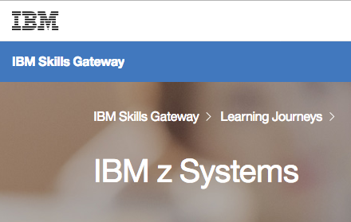
Fact
…and our IBM Global Training Providers and affiliates
35% off
Virtual Classes through August
“SPVC35”
LearnQuest
Arrow
Global Knowledge
Avnet
Ingram Micro
Interskill including free course demos
ProTech and Mentor Services
Visit our IBM z Systems Skills Gateway
20
Notes:
ProTech: Mainframe training and Bootcamps
Kick off your summer with 35% off all IBM self-paced virtual courses (SPVCs) when you use the discount code SPVC35 now through August 31, 2017.

Slide 22
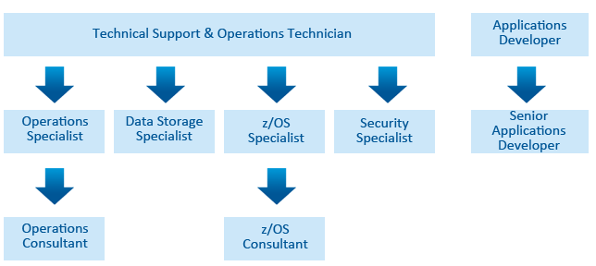
Fact
There are even professional mainframe exams
Level 1
MTP Applications Developer
MTP Technician (Technical Support & Operations)
Level 2
MTP Senior Applications Developer
MTP Specialist (Data Storage)
Level 3
MTP Consultant (Operations)
MTP Specialist (Operations)
MTP Specialist (Security)
MTP Specialist (z/OS)
MTP Consultant (z/OS)
…including a FREE Mainframe Foundation Test!
21
Notes:
It is a free one-hour online test consisting of 30 questions. These questions are drawn from the three topics that successful candidates should be proficient in. When the test is completed scores are given in each of the three topics and areas of concern highlighted.

Slide 23
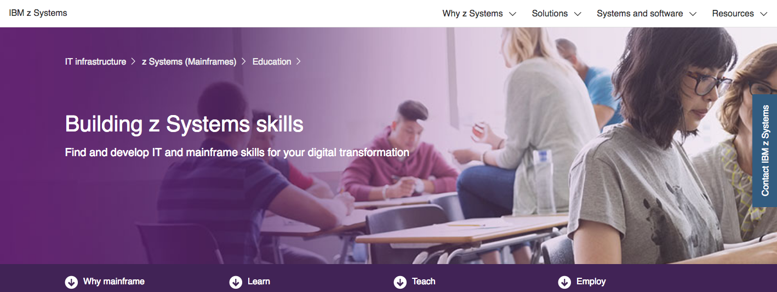
Fact
Visit the z Skills Website for more resources
22
Notes:
It is a free one-hour online test consisting of 30 questions. These questions are drawn from the three topics that successful candidates should be proficient in. When the test is completed scores are given in each of the three topics and areas of concern highlighted.

Slide 24

Myth
Keeping a millennial on z is as difficult as raising one eyebrow!

Slide 25
Insight
Get them involved and become part of the z community!
Recent Hires
Assign Mentors
Provide a Creative and Positive Environment (Radical Recess)
Send them out to Recruit
Hire in pairs (at a minimum)
Offer leadership opportunities
Allow them to attend conferences
Send to a Free Gen z Event
Join the z Advocacy Hub
24
Notes:
.

Slide 26

Dispel the myths and start filling your z pipeline today!
Millennials will work on z, and will even enjoy it
Effective z training is available
Young people are building z skills
IBM is here to help!

Slide 27









Contact us
Meredith Stowell
Director, Ecosystems for z Systems
meredith.stowell@us.ibm.com
Christy Schroeder
Client Skills Leader
christys@us.ibm.com
Misty Decker
zAI Pgm Mgr
misty@us.ibm.com
Klaus Rutsch
Europe AI Pgm Mgr
rutsch@de.ibm.com
Ludmila Canuto de Melo Ferreira Salimena
Brazil AI Pgm Mgr
ludmilas@br.ibm.com
Tian Tian
China AI Pgm Mgr tiantcdl@cn.ibm.com
Paul Newton
MtM IT Specialist
paulnewt@us.ibm.com
Troy Crutcher
MtM AI Pgm
tdcrutch@us.ibm.com

